Slide 1

Page Replacement
PASS
CS532: OS Foundations
Lab Assignment
Email: chitram2@pdx.edu

Slide 2
Instructions: Make a copy of this document, move your copy to your submissions folder and fill the document with your responses. Use the space on each slide to show your responses, and add additional slides as needed.
When ready for grading: complete the lab assignment submission form and include a link to your filled document

Slide 3
paging-policy.py
Find the paging-policy.py program within the vm-beyondphys-policy sub-directory of your ostep-homework directory. Use paging-policy.py to experiment with various page-replacement policies.
Read the README.md file in the sub-directory and run the program with the --help switch to learn more about this simulator’s features.

Slide 4
1. Use paging-policy.py to generate random address traces using the following command line arguments. The program also simulates a page replacement policy such as FIFO, LRU and OPT. Fill the following table with number of page misses for each scenario :
(first, run without the -c option and calculate #misses yourself. then use -c to check your work)
 | FIFO | LRU | OPT
-s 0 -n 15 | 13 | 12 | 10
-s 1 -n 15 | 12 | 12 | 8
-s 2 -n 15 | 11 | 11 | 9
Good

Slide 5
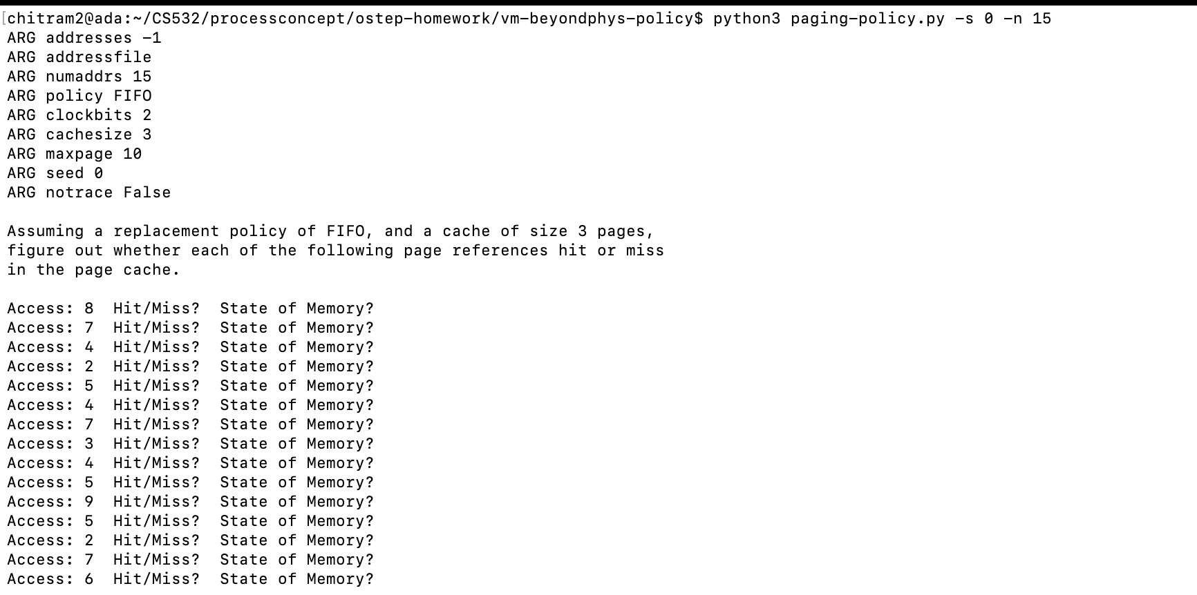
FIFO: -s 0 -n 15

Slide 6
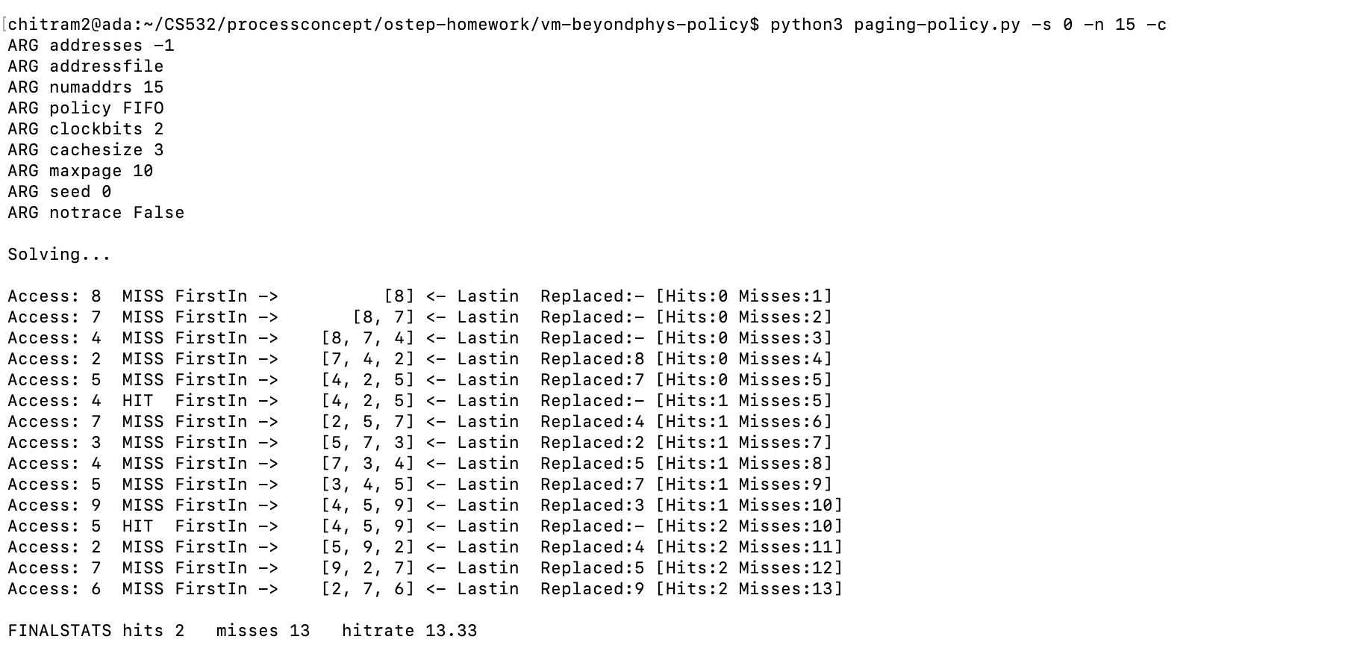
FIFO: -s 0 -n 15 -c

Slide 7
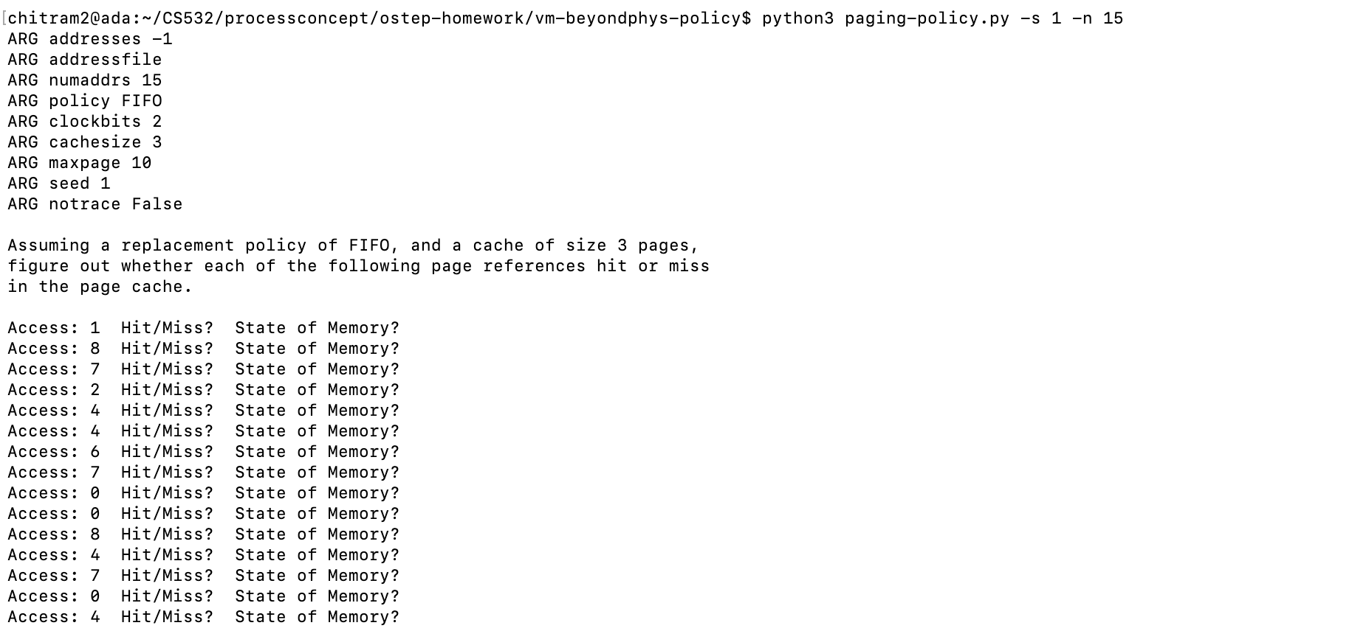
FIFO: -s 1 -n 15

Slide 8
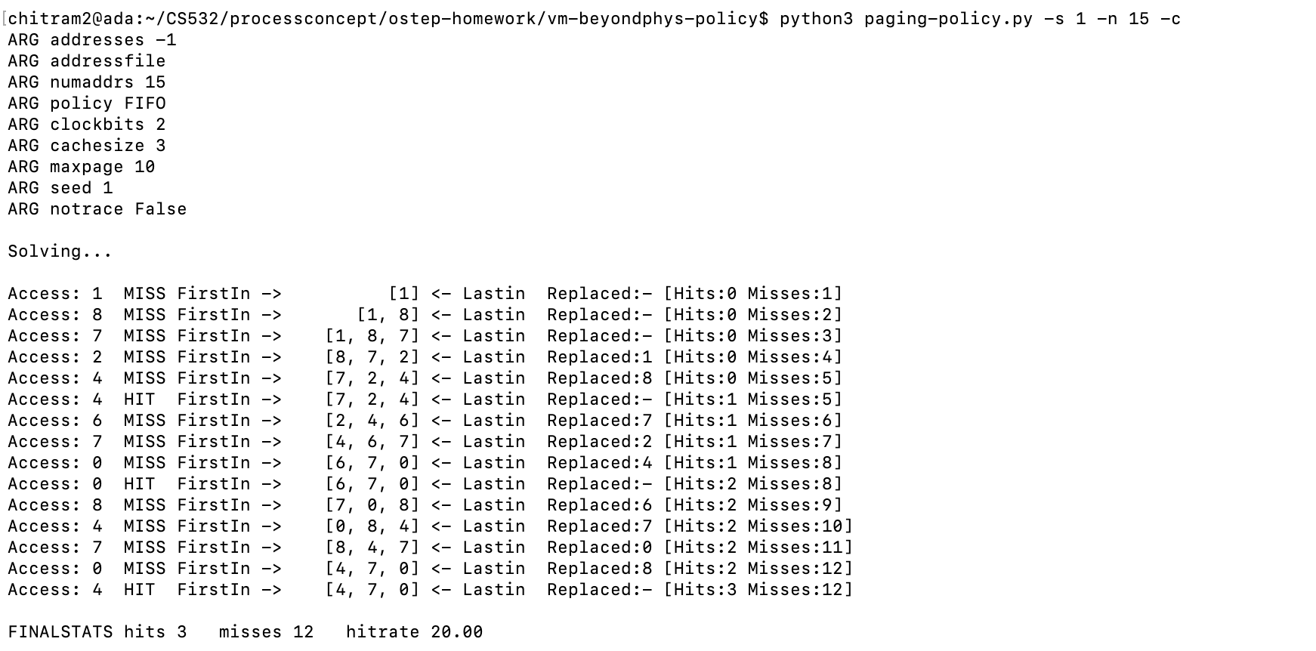
FIFO: -s 1 -n 15 -c

Slide 9
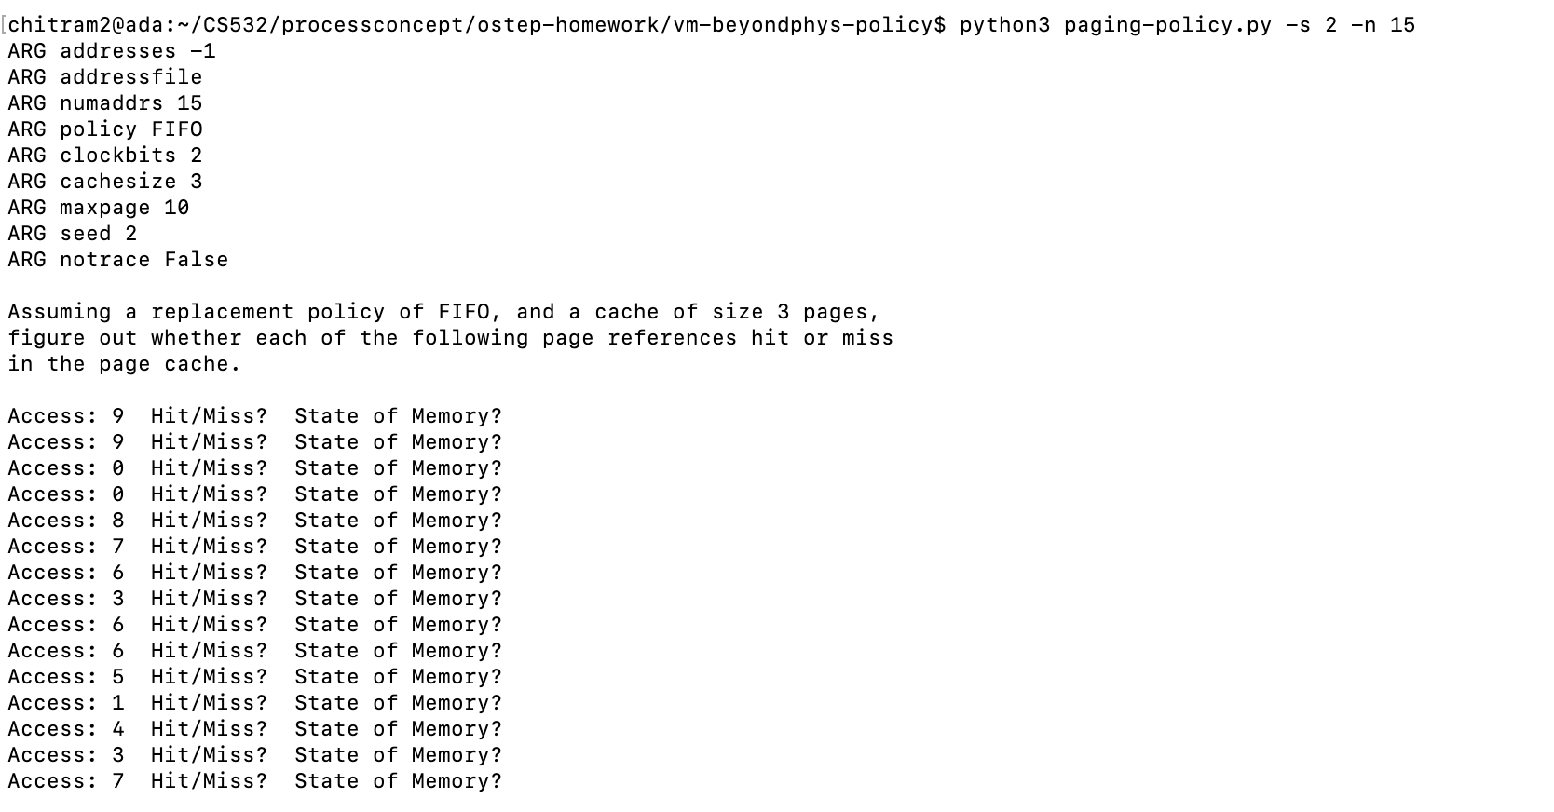
FIFO: -s 2 -n 15

Slide 10
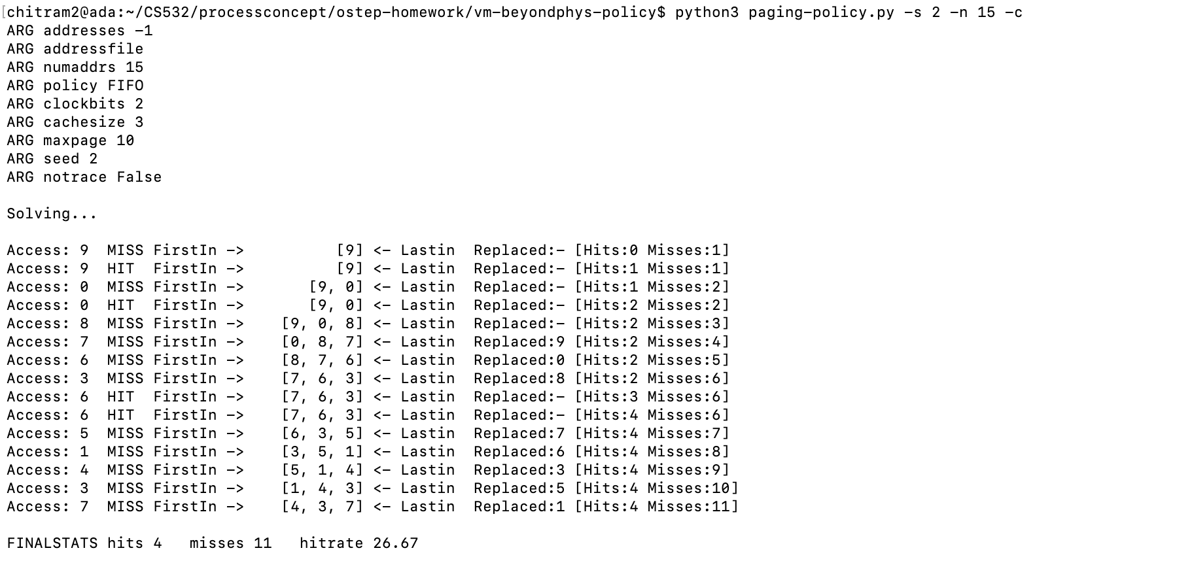
FIFO: -s 2 -n 15 -c

Slide 11
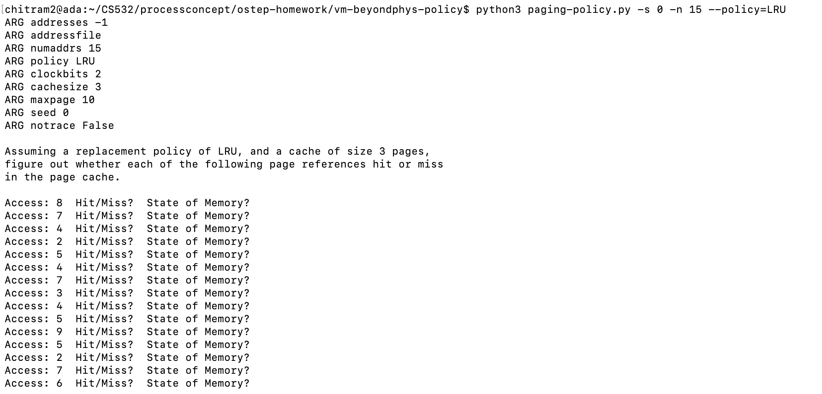
LRU: -s 0 -n 15

Slide 12
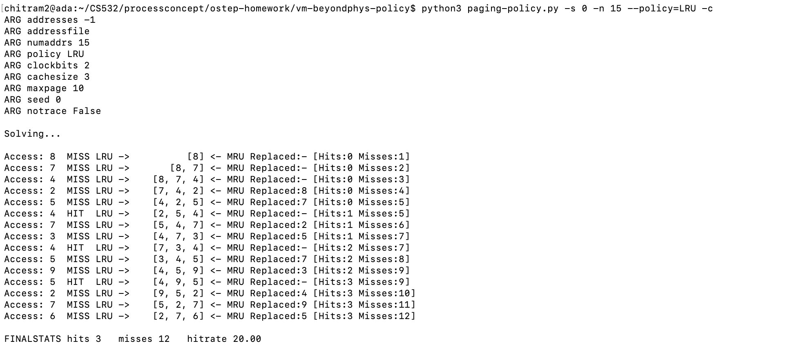
LRU: -s 0 -n 15 -c

Slide 13
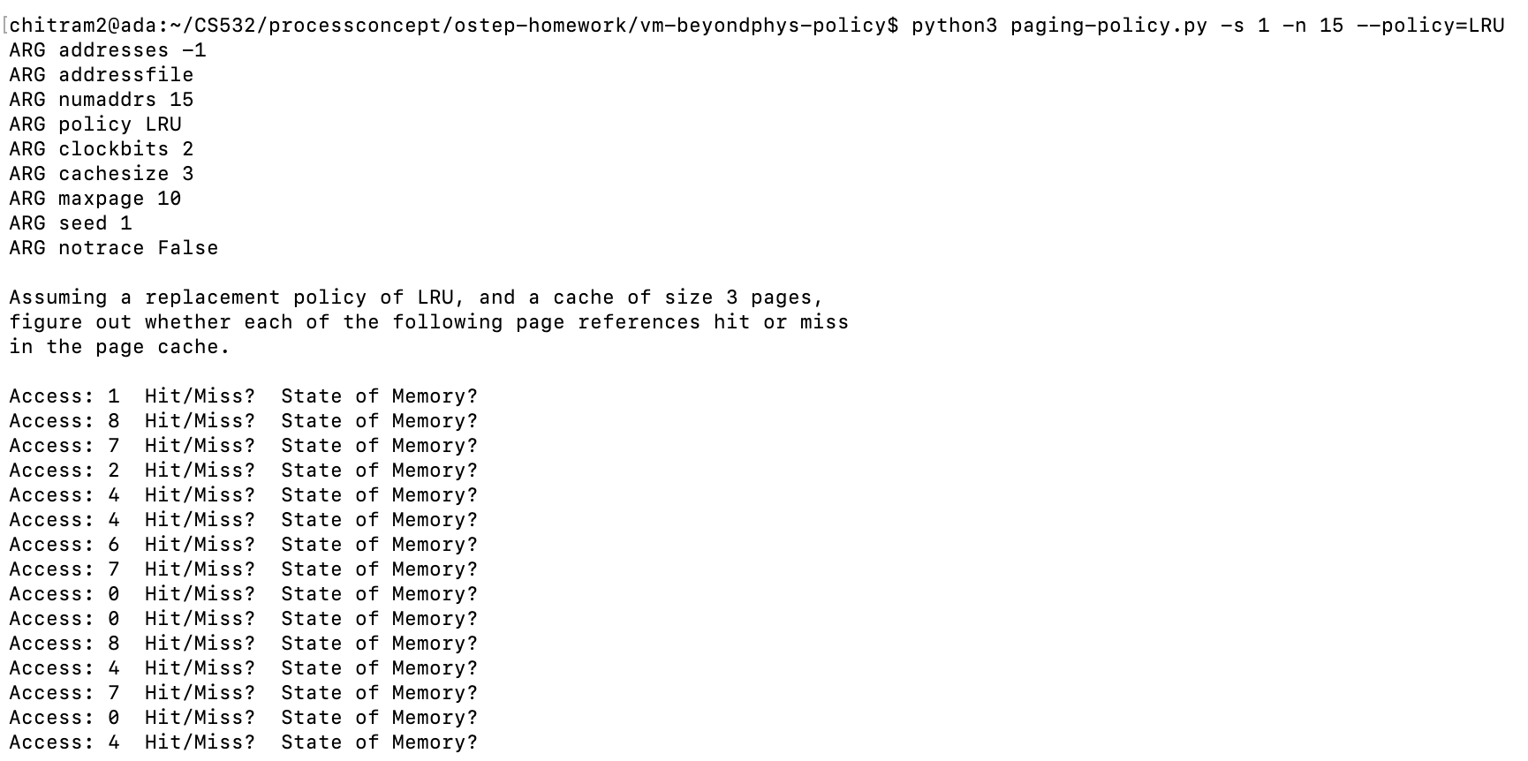
LRU: -s 1 -n 15

Slide 14
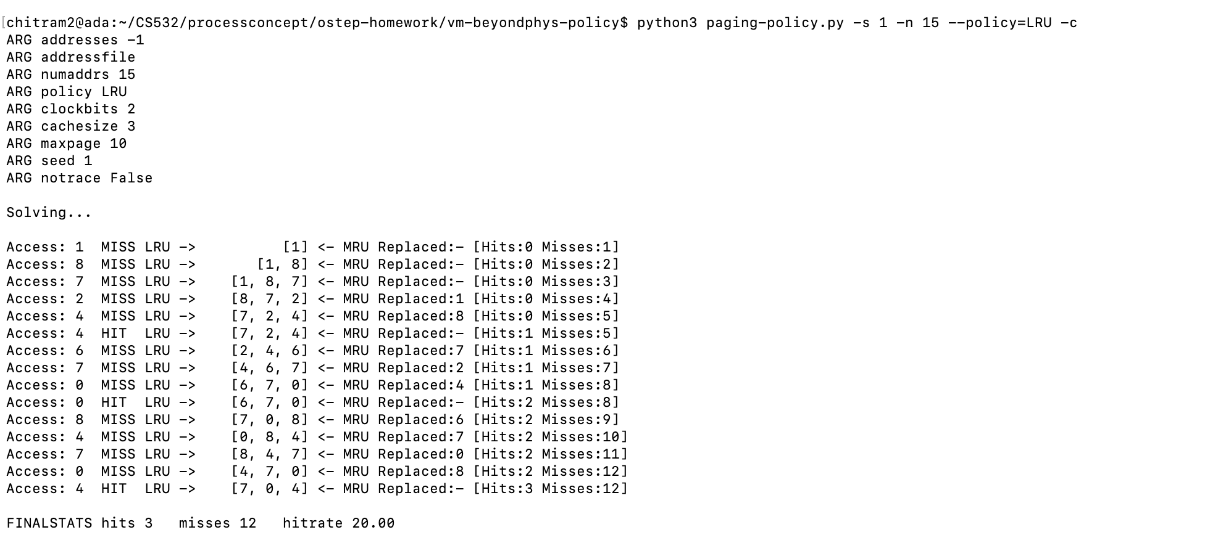
LRU: -s 1 -n 15 -c

Slide 15
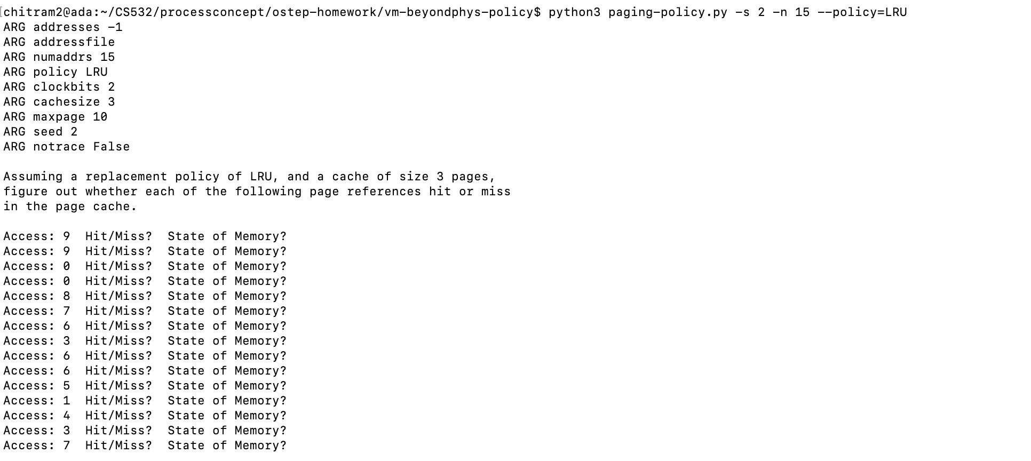
LRU: -s 2 -n 15

Slide 16
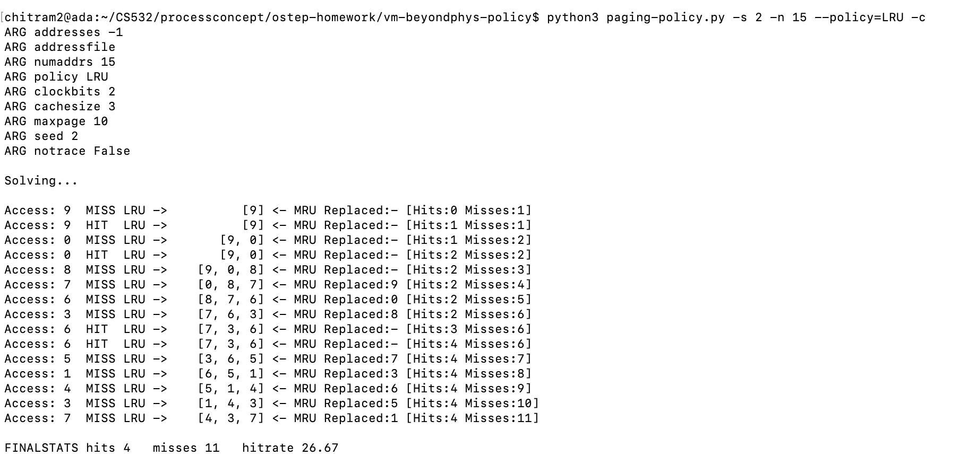
LRU: -s 2 -n 15 -c

Slide 17

OPT: -s 0 -n 15

Slide 18
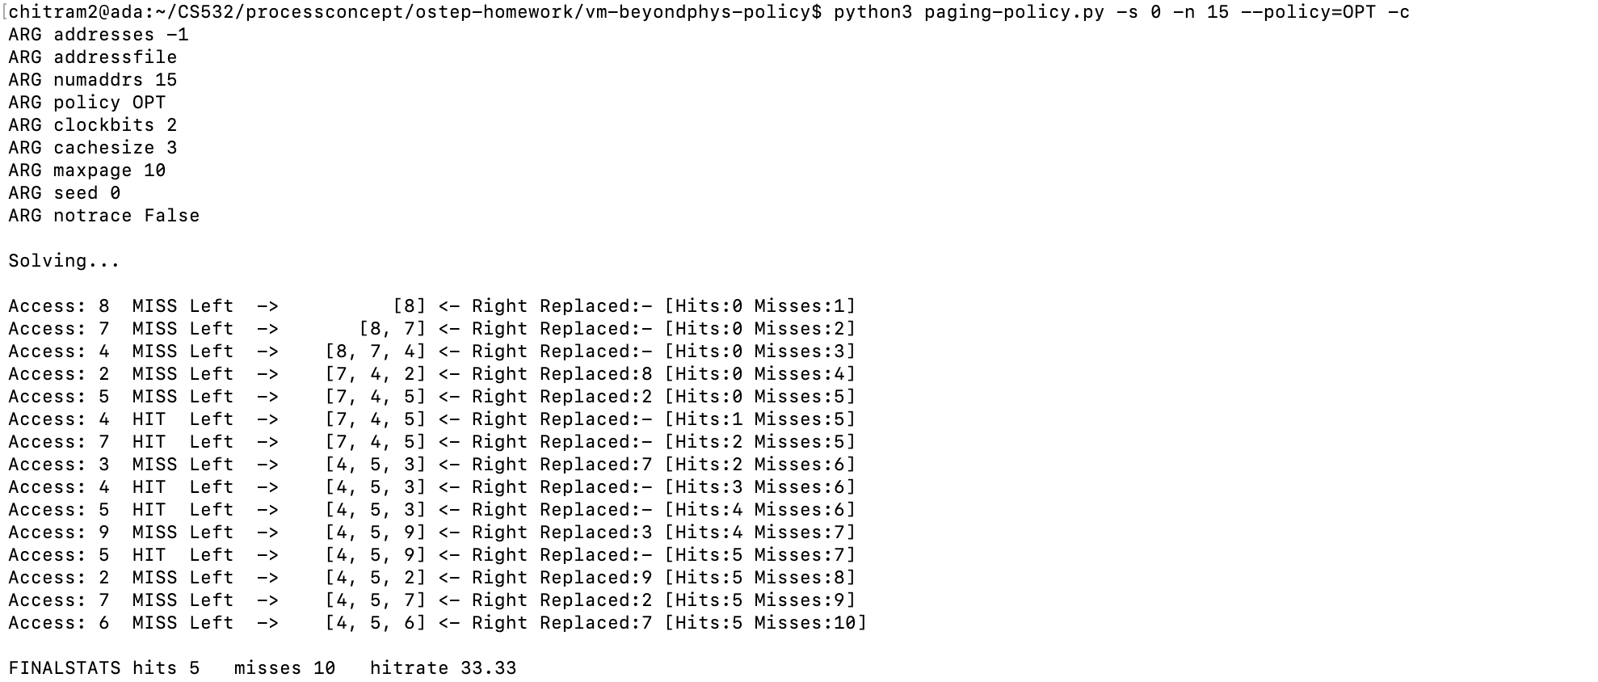
OPT: -s 0 -n 15 -c

Slide 19
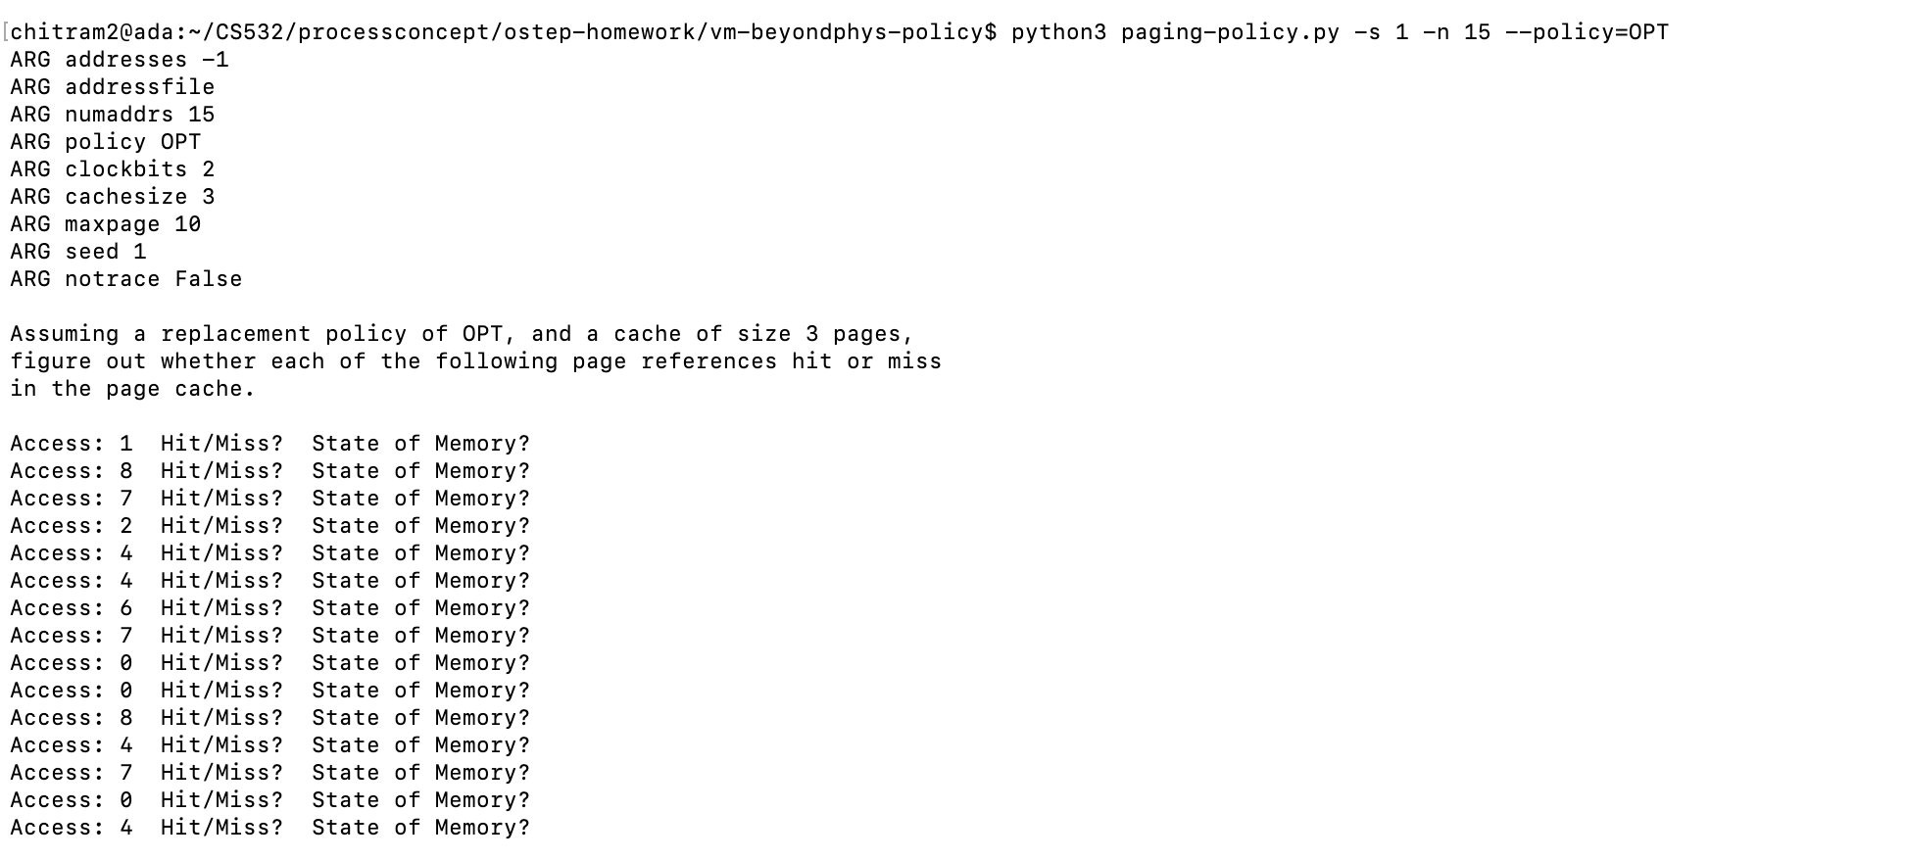
OPT: -s 1 -n 15

Slide 20
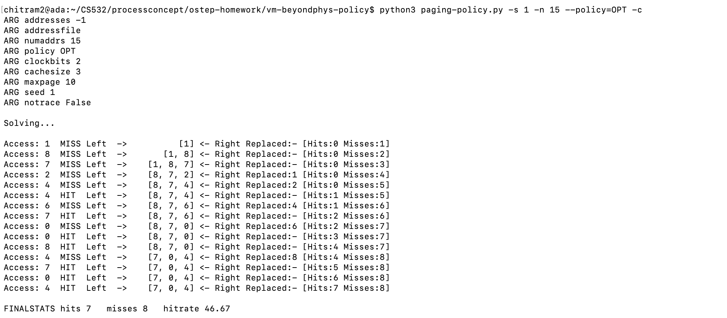
OPT: -s 1 -n 15 -c

Slide 21
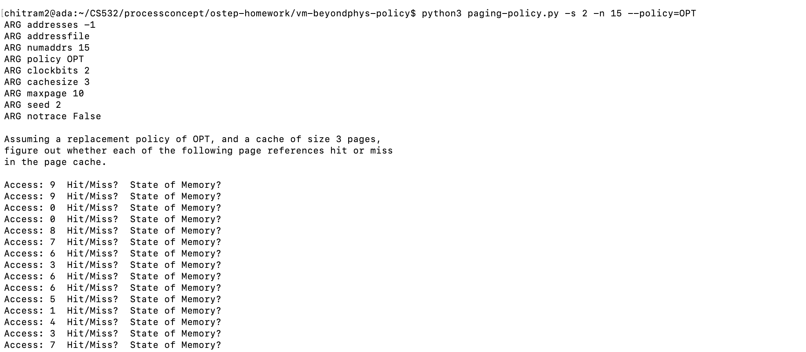
OPT: -s 2 -n 15

Slide 22
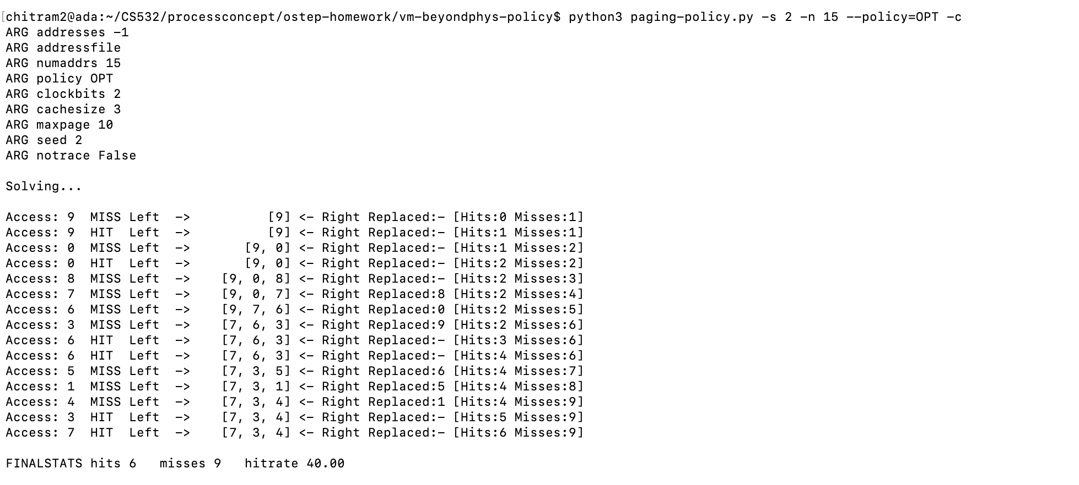
OPT: -s 2 -n 15 -c

Slide 23
2. For a cache of size 5, create worst-case address reference streams for each of the following policies: FIFO, LRU, and MRU (worst-case reference streams cause the most misses possible. For the worst case reference streams, how much bigger of a cache is needed to improve performance dramatically and approach OPT?

Slide 24
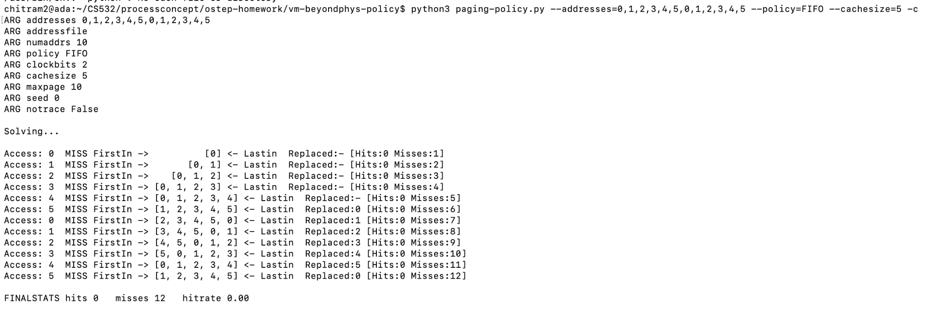
1)python3 paging-policy.py --addresses=0,1,2,3,4,5,0,1,2,3,4,5 --policy=FIFO --cachesize=5 -c
Good

Slide 25
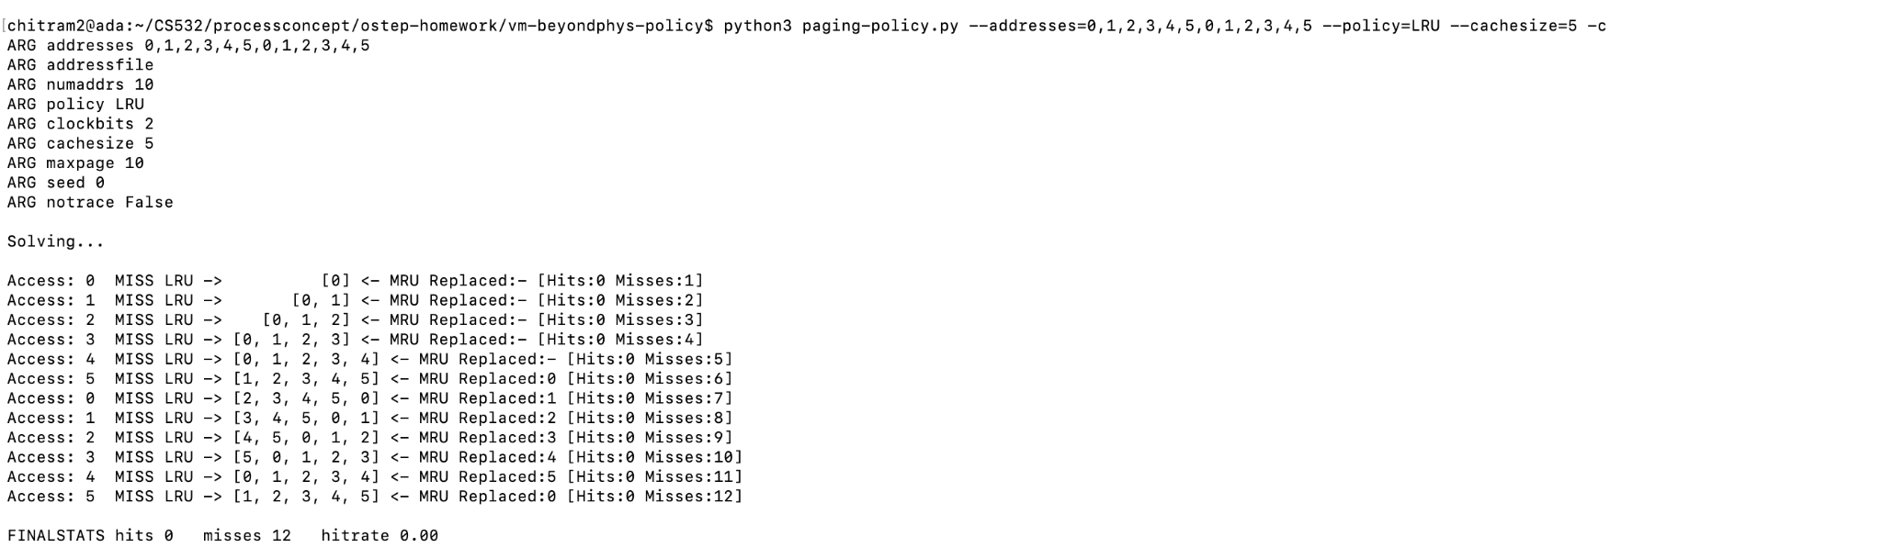
2)python3 paging-policy.py --addresses=0,1,2,3,4,5,0,1,2,3,4,5 --policy=LRU --cachesize=5 -c
Good

Slide 26
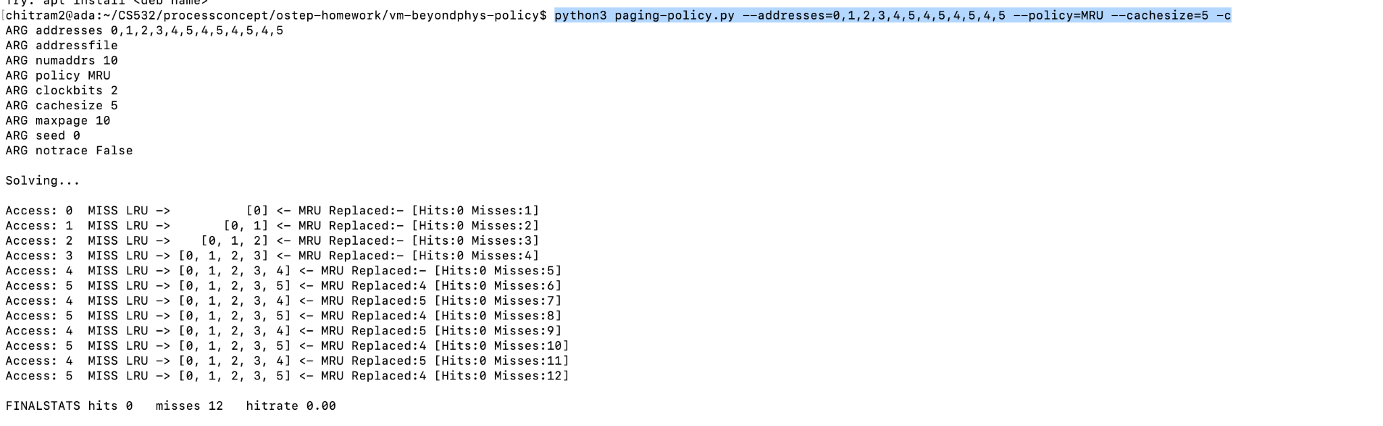
3)python3 paging-policy.py --addresses=0,1,2,3,4,5,4,5,4,5,4,5 --policy=MRU --cachesize=5 -c
Looks good now

Slide 27
For the worst case reference streams, how much bigger of a cache is needed to improve performance dramatically and approach OPT?
Answer: one
Good

Slide 28
3. Generate random traces using the following settings.
 | FIFO | RAND | LRU | OPT
-a -1 -n 1000 -m 50 -s 10 -C 10 -c | 804 | 818 | 808 | 522
-a -1 -n 1000 -m 50 -s 20 -C 10 -c | 798 | 803 | 795 | 513
-a -1 -n 1000 -m 50 -s 30 -C 10 -c | 789 | 789 | 784 | 513
3A. Fill in the cells with the number of misses for each policy. Use the -c switch for these computations.
Good

Slide 29
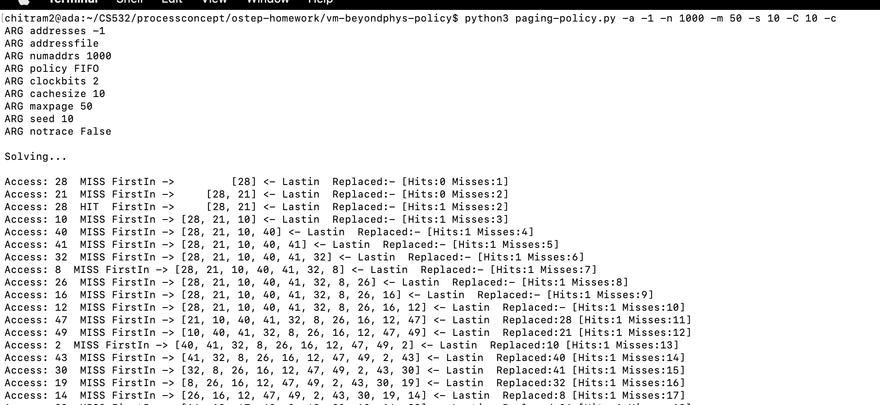
FIFO: -a -1 -n 1000 -m 50 -s 10 -C 10 -c

Slide 30
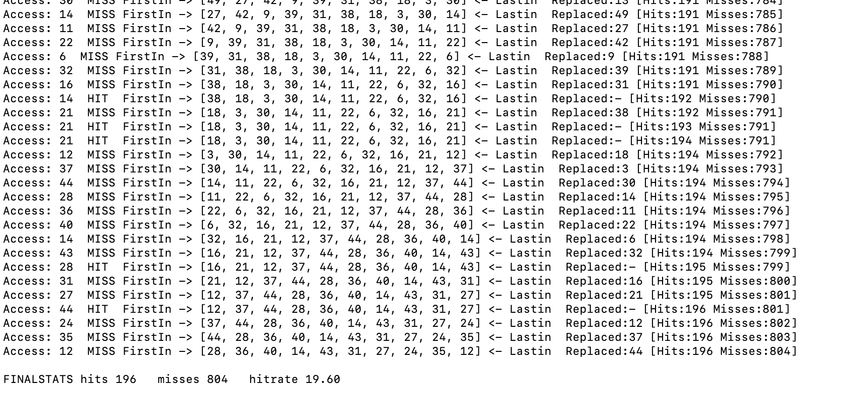

Slide 31
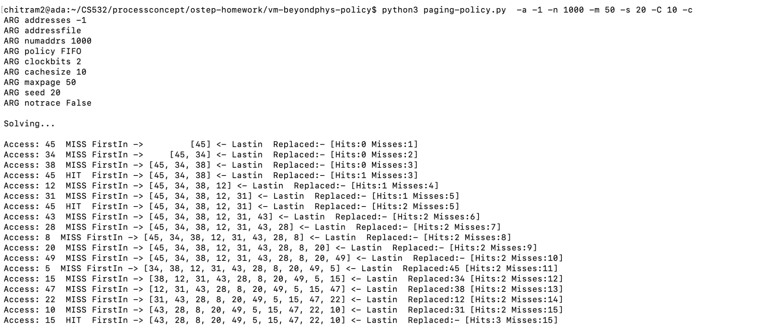
FIFO: -a -1 -n 1000 -m 50 -s 20 -C 10 -c

Slide 32
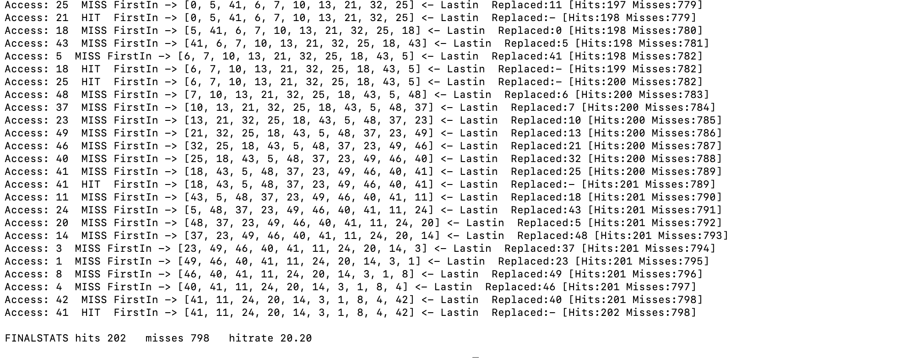

Slide 33
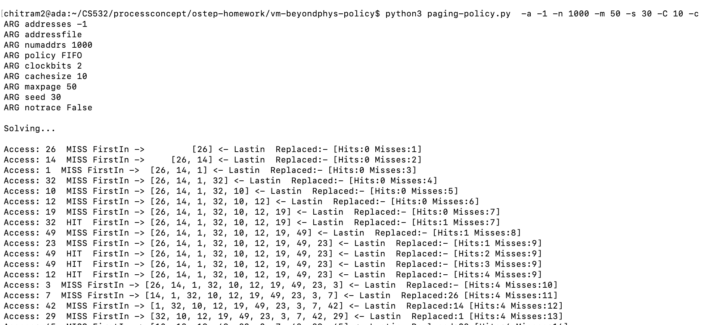
FIFO: -a -1 -n 1000 -m 50 -s 30 -C 10 -c

Slide 34
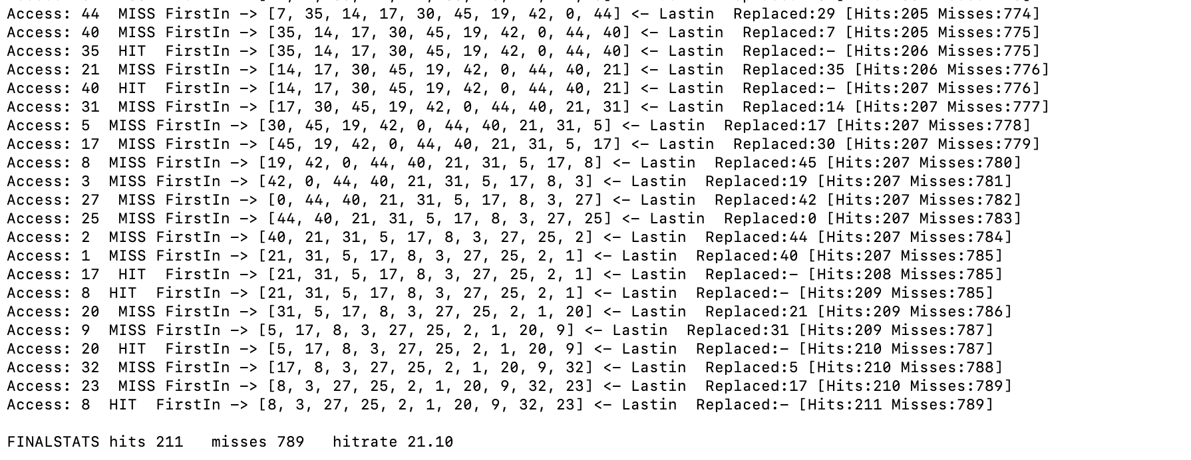

Slide 35
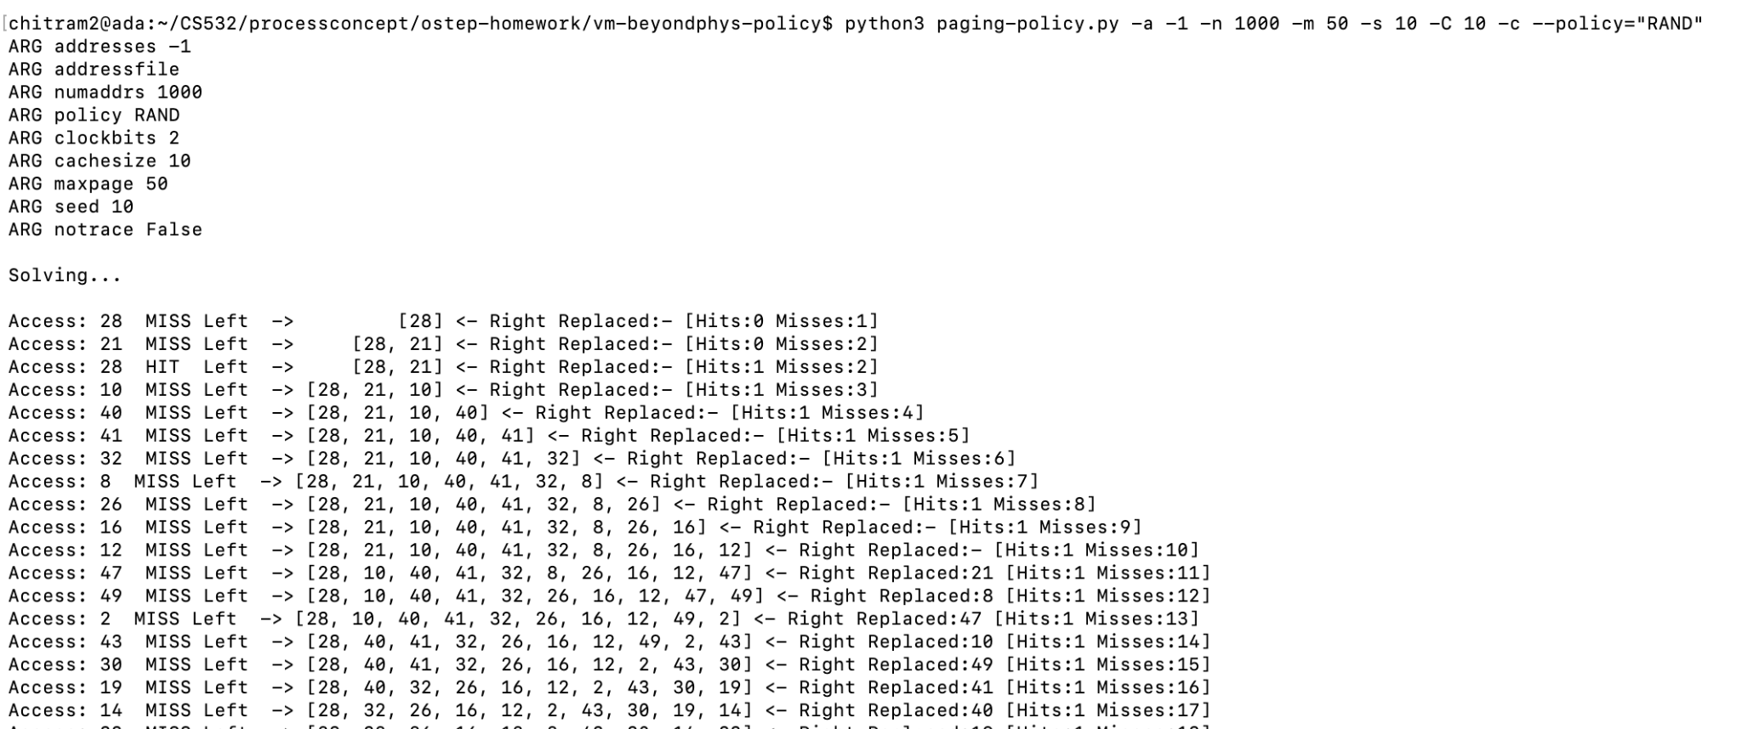
RAND: -a -1 -n 1000 -m 50 -s 10 -C 10 -c

Slide 36
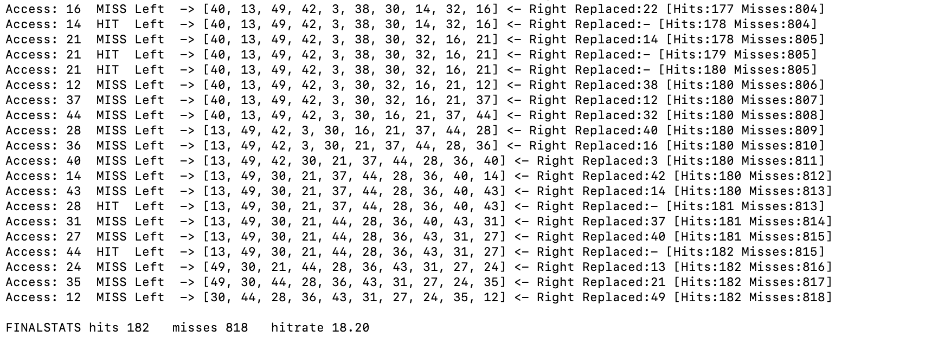

Slide 37
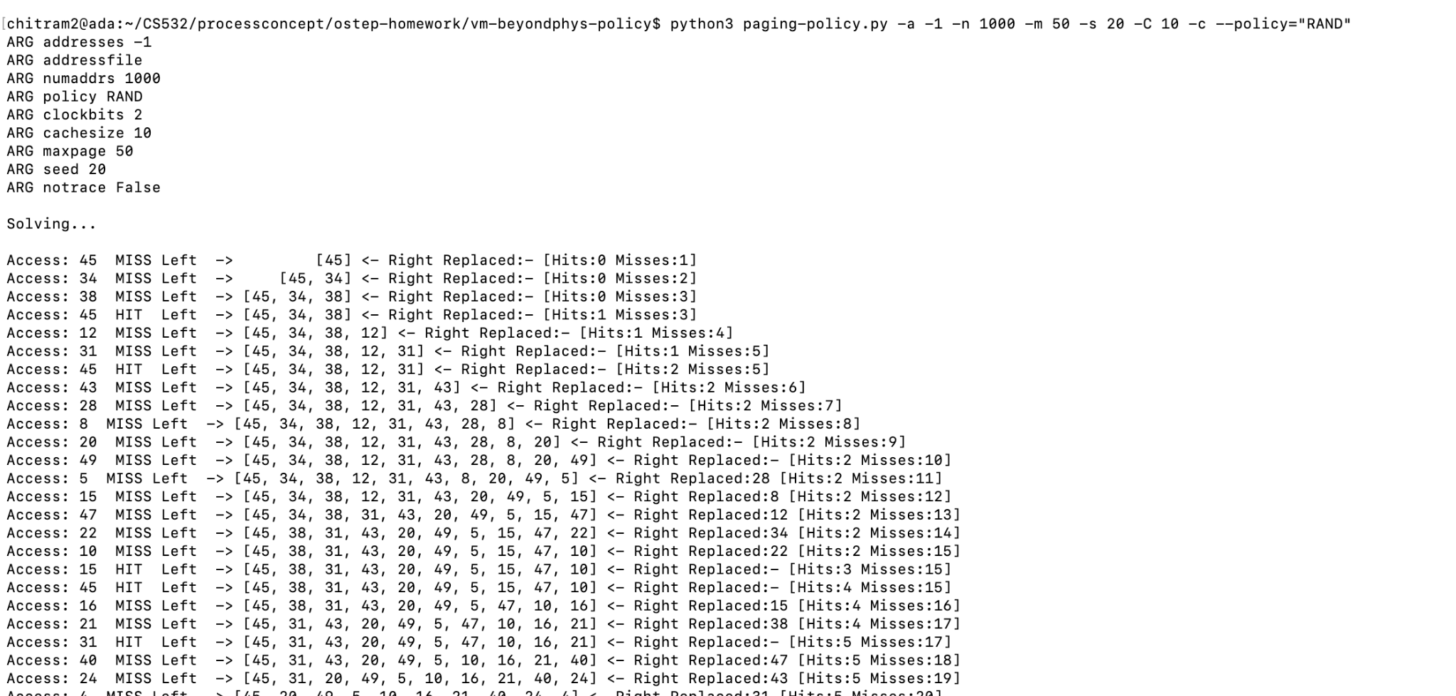
RAND: -a -1 -n 1000 -m 50 -s 20 -C 10 -c

Slide 38
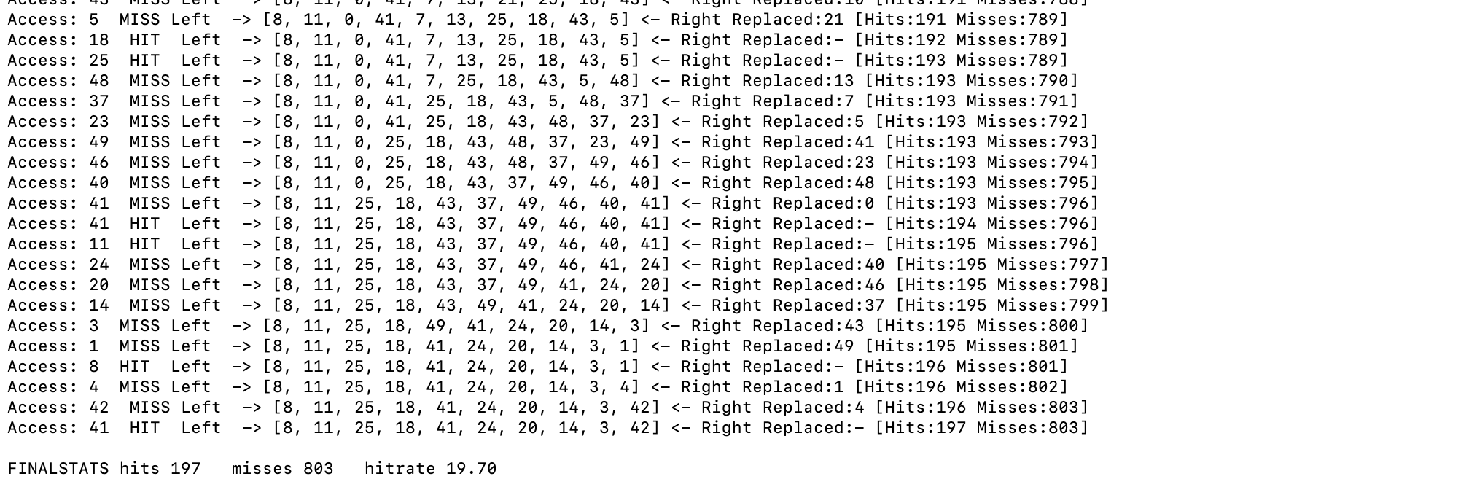

Slide 39
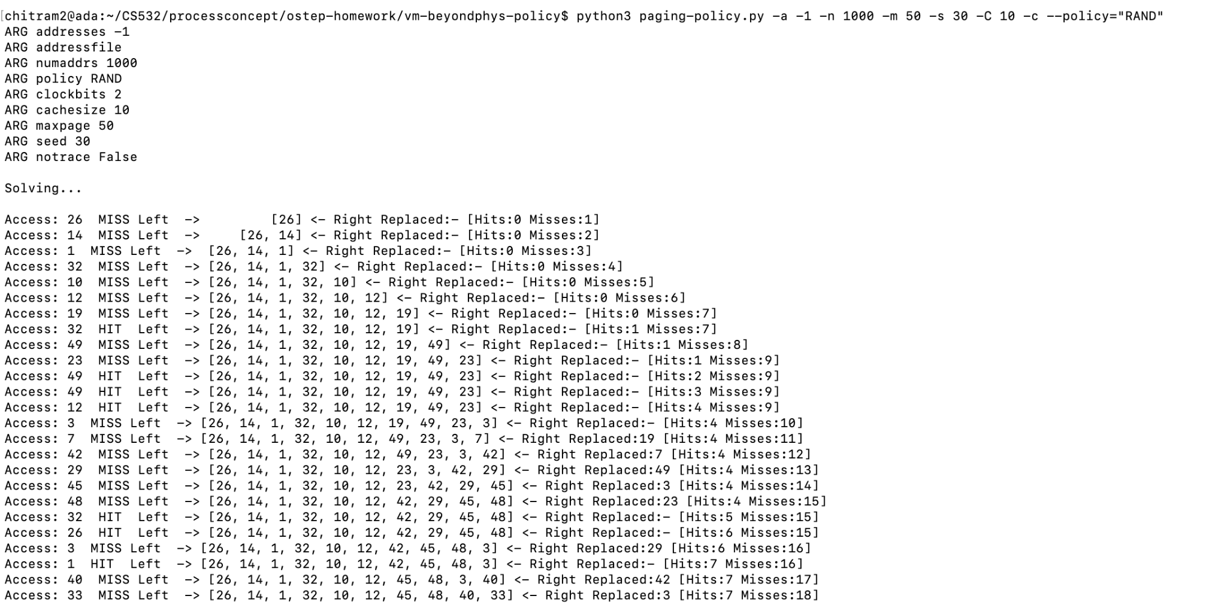
RAND: -a -1 -n 1000 -m 50 -s 30 -C 10 -c

Slide 40
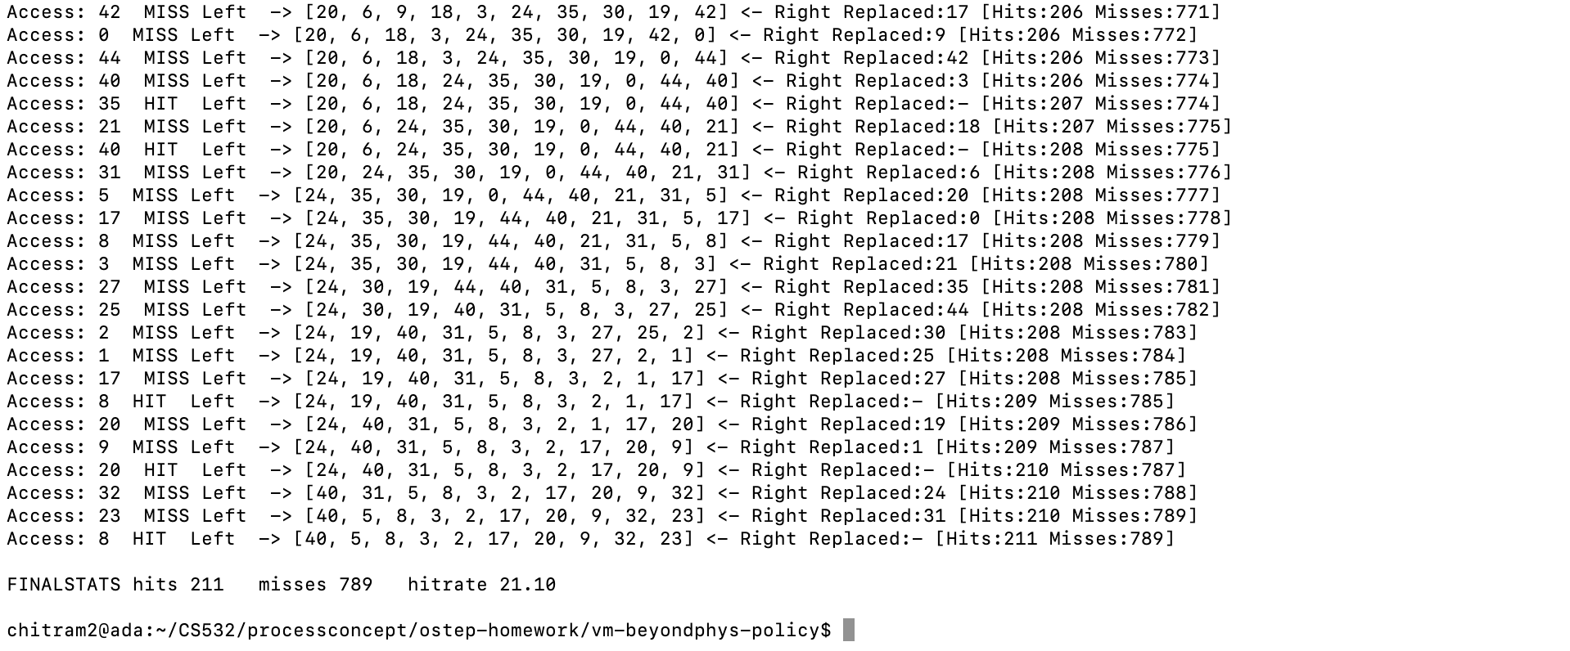

Slide 41
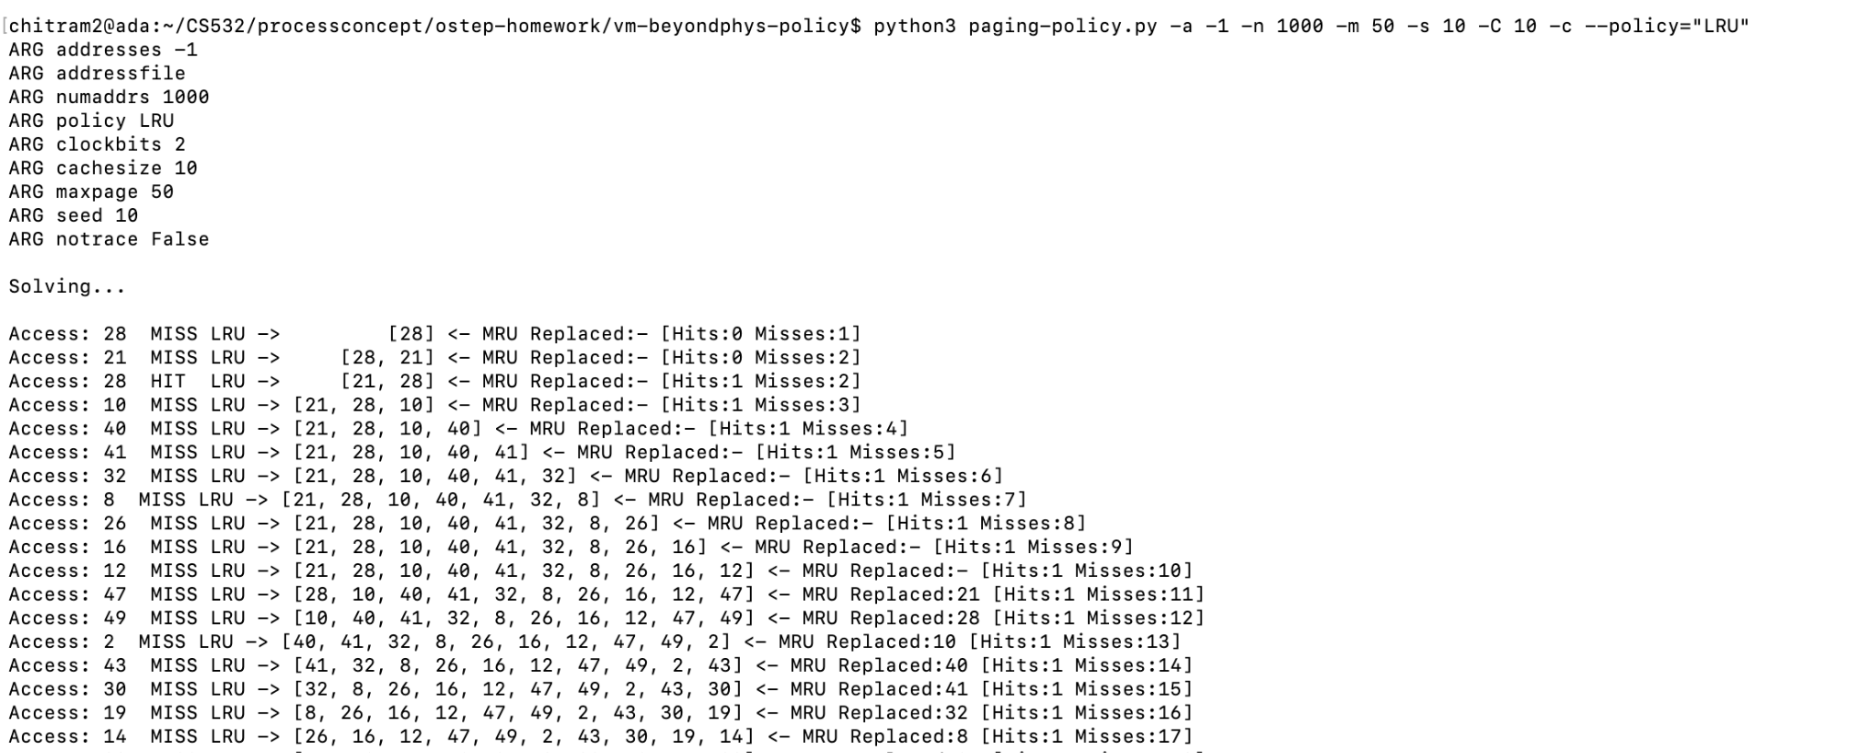
LRU: -a -1 -n 1000 -m 50 -s 10 -C 10 -c

Slide 42
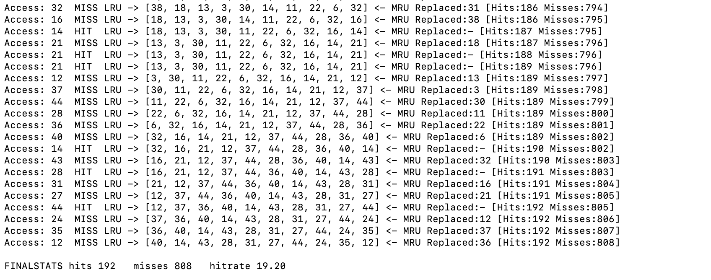

Slide 43
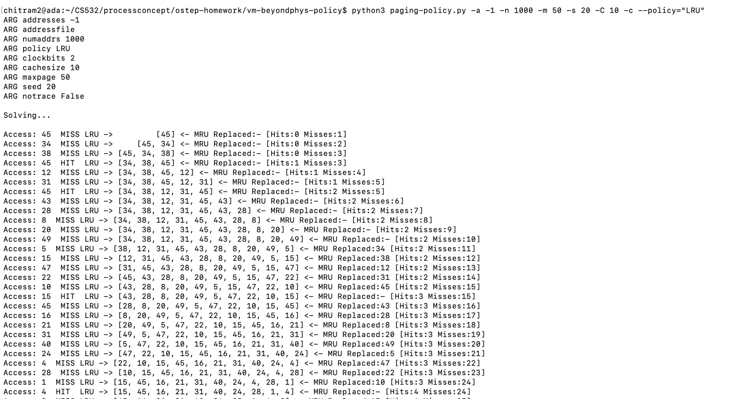
LRU: -a -1 -n 1000 -m 50 -s 20 -C 10 -c

Slide 44
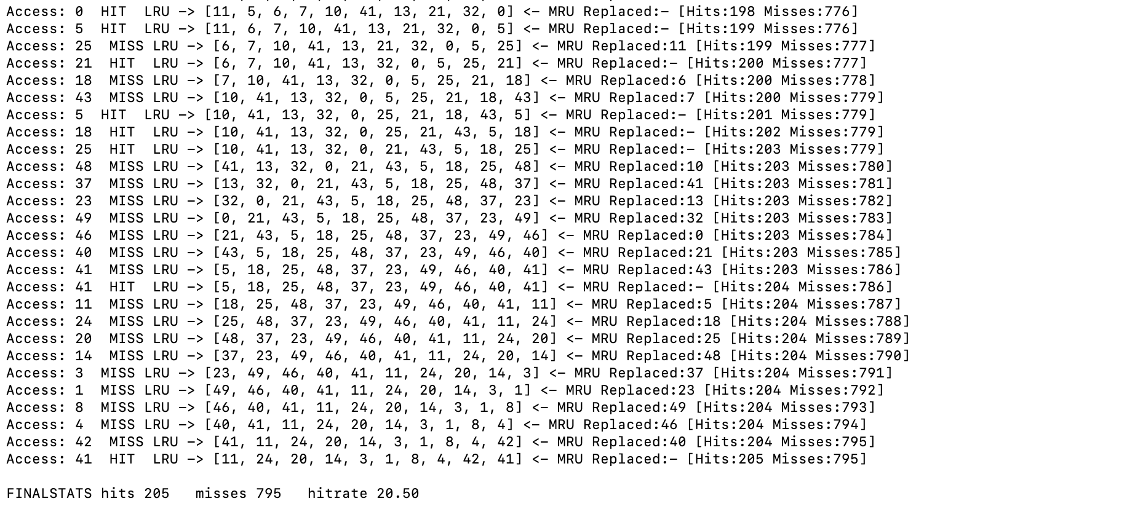

Slide 45
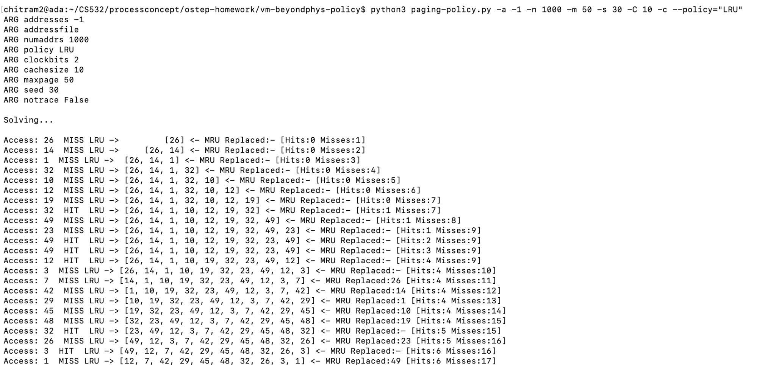
LRU: -a -1 -n 1000 -m 50 -s 30 -C 10 -c

Slide 46
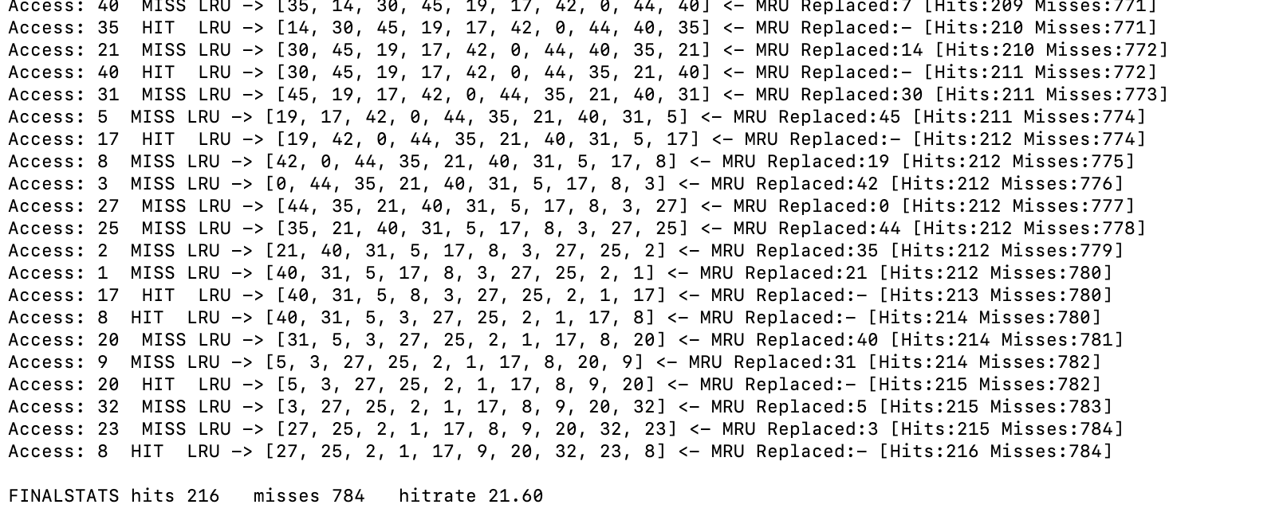

Slide 47
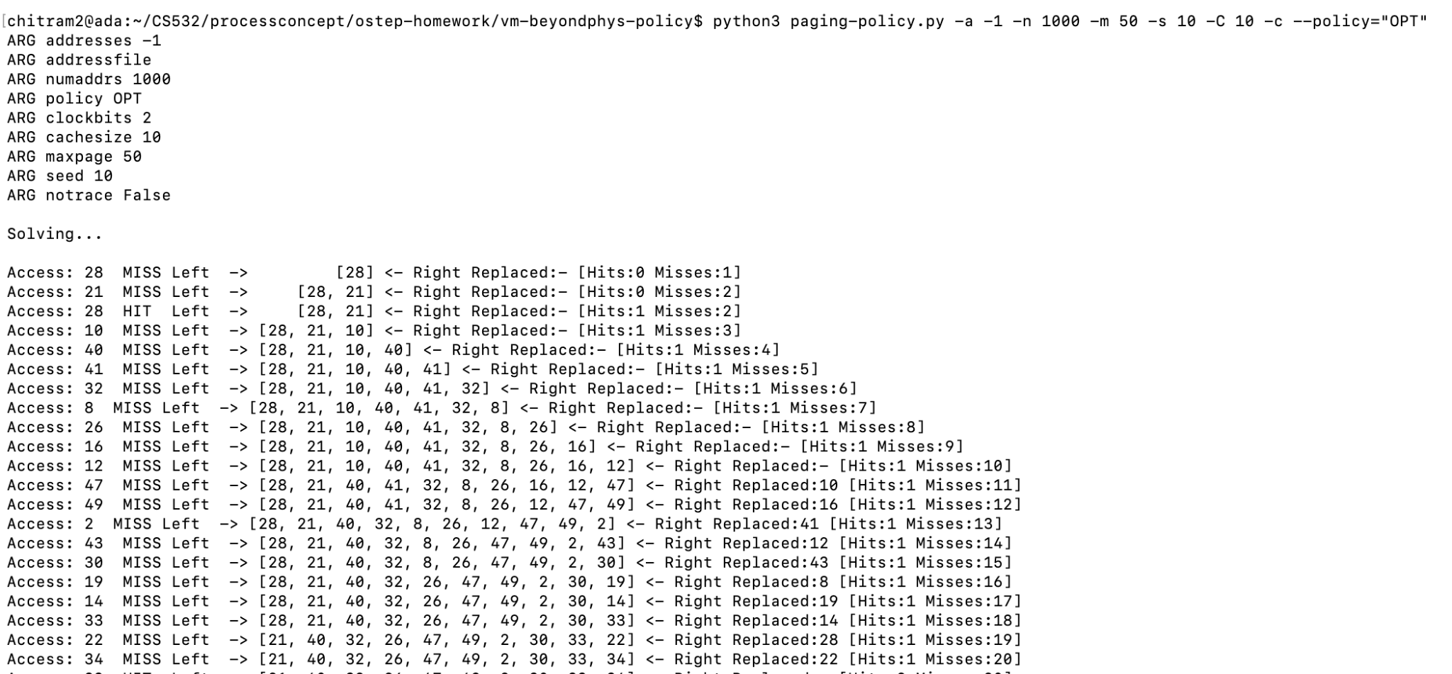
OPT: -a -1 -n 1000 -m 50 -s 10 -C 10 -c

Slide 48
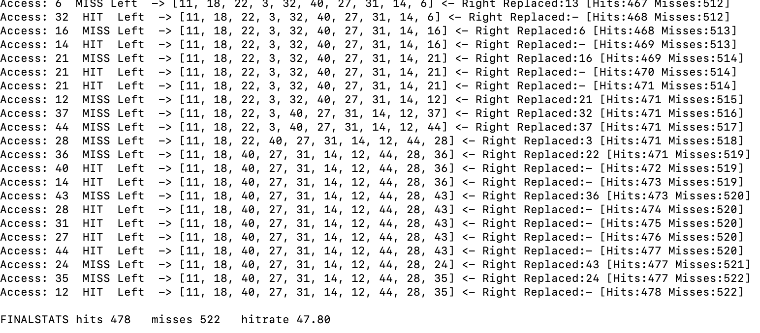

Slide 49
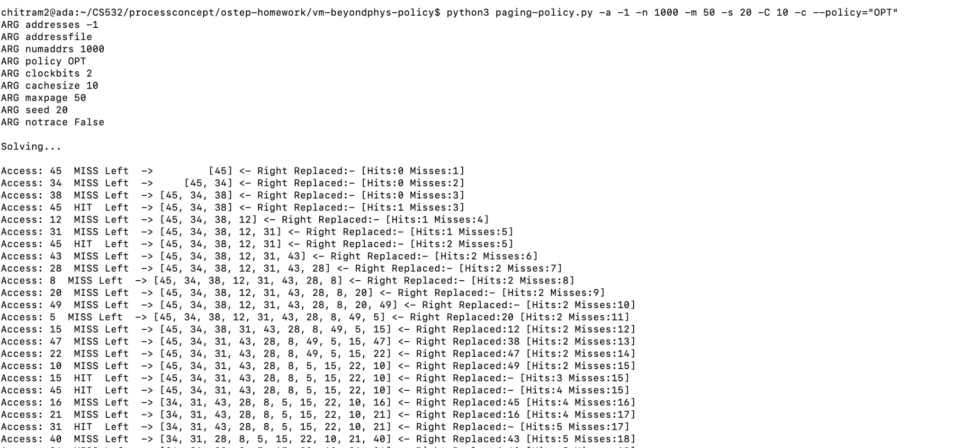
OPT: -a -1 -n 1000 -m 50 -s 20 -C 10 -c

Slide 50
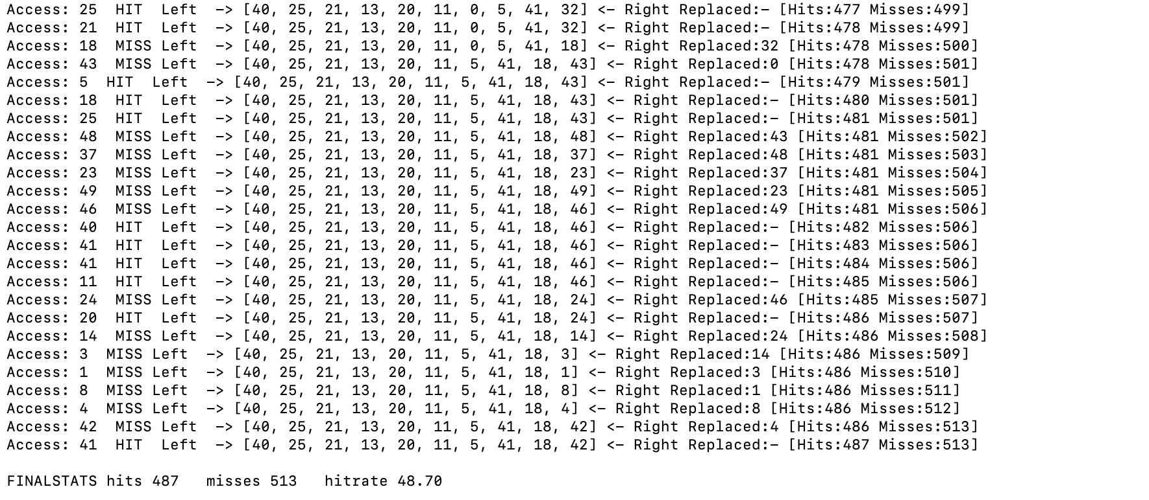

Slide 51
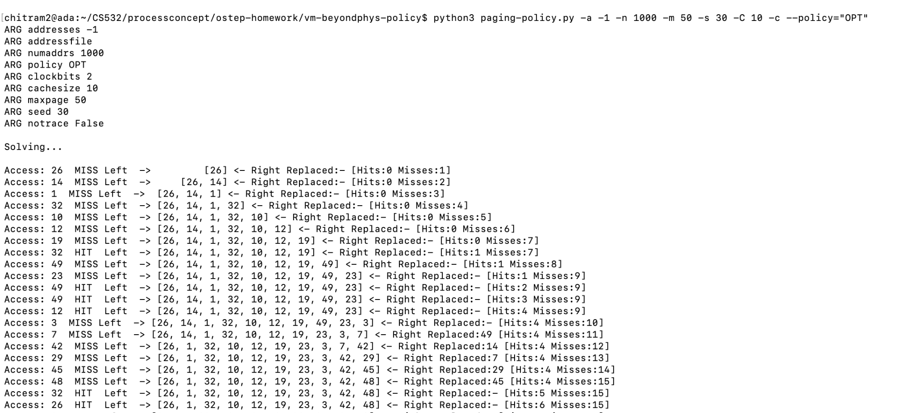
OPT: -a -1 -n 1000 -m 50 -s 30 -C 10 -c

Slide 52
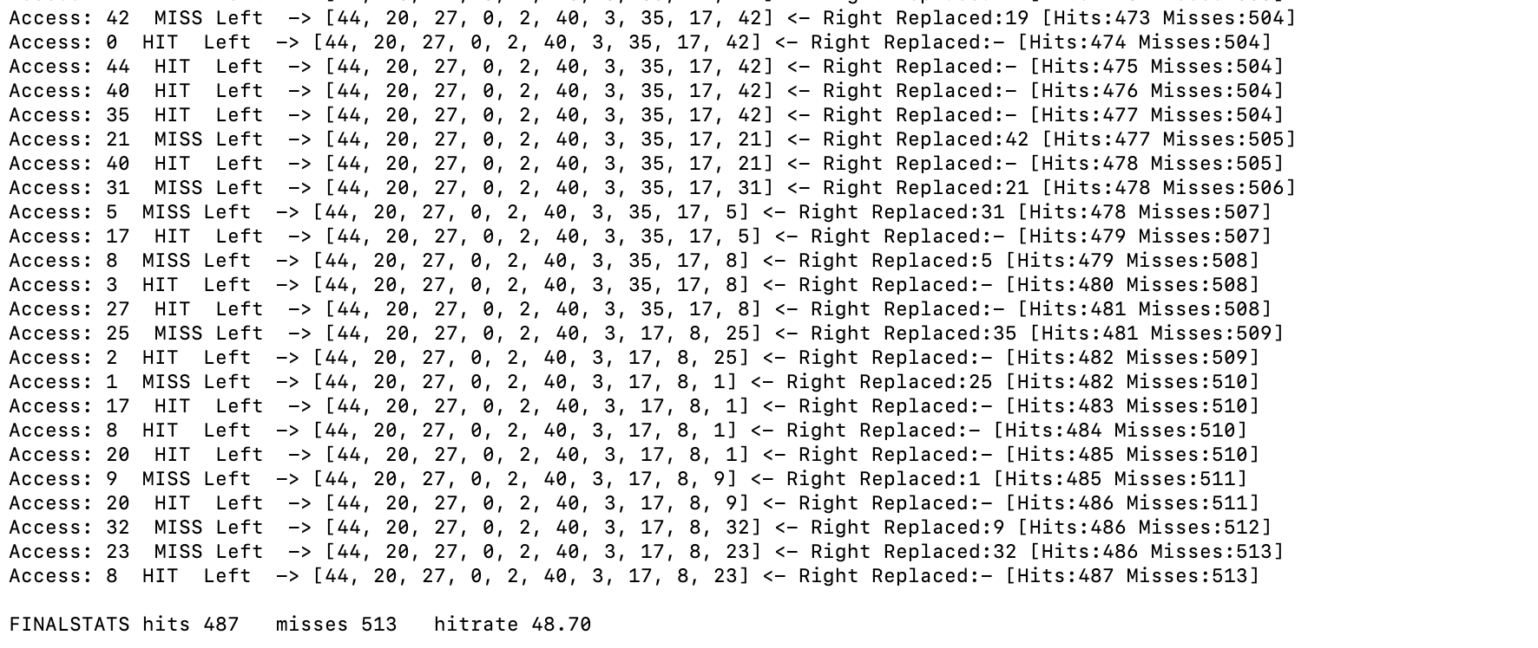

Slide 53
3B. What do you observe about the relative performance of the three algorithms for this -m 50 -C 10 scenario?
Answer:
1)OPT is the most optimal page replacement algorithm. OPT performs better than the other algorithms because pages are replaced which would not be used for the longest duration of time in the future, i.e., the pages in the memory which are going to be referred farthest in the future are replaced.
2) FIFOand LRU performs almost similarly without much difference in their hit-rates and misses.
3)RAND performance misses are highest.
Good

Slide 54
3B. Next, vary -m and -C systematically and observe the change in performance of the four algorithms as you vary the scenarios. What can you conclude about the relative performance of the four algorithms over the range of scenarios that you observed?
Answer:
It can be seen that the OPT performs the best followed by LRU, RAND and the FIFO respectively.
OPT performs best in all the scenarios.
LRU is better than FIFO and RAND in most of the scenarios
When we vary the cache size, then LRU is more efficient for small caches but scales poorly to larger ones.
Good

Slide 55
4. On babbage.cs.pdx.edu, find the files contained in the /tmp directory (and all sub-directories).
Do it like this: find /tmp -type f
4A. How many files are in your system’s /tmp directory (and sub-directories)? One easy way to do this is to pipe the output of the find command through the wc program, like this: find /tmp -type f | wc

Slide 56
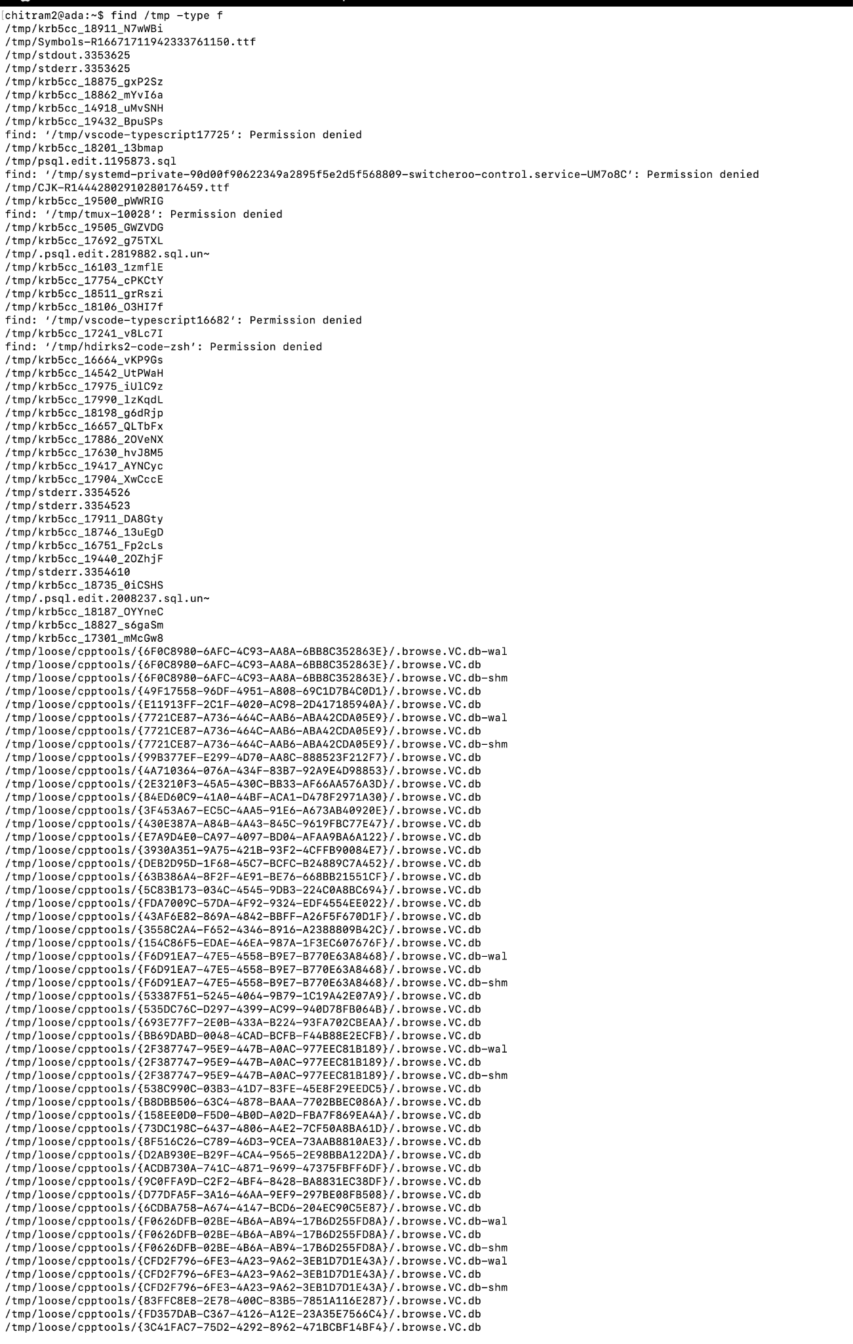

Slide 57
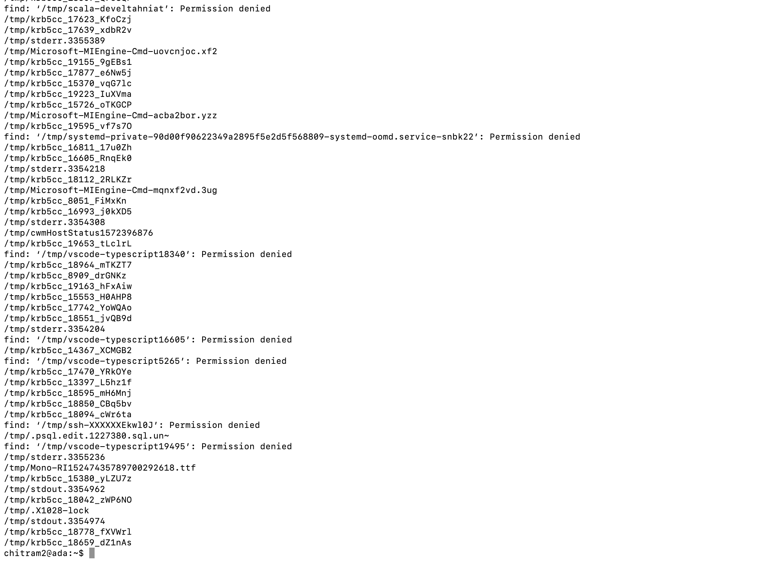

Slide 58
4A. How many files are in your system’s /tmp directory (and sub-directories)? One easy way to do this is to pipe the output of the find command through the wc program, like this: find /tmp -type f | wc
Answer
767 files present in the /tmp directory of the system
Looks good now

Slide 59
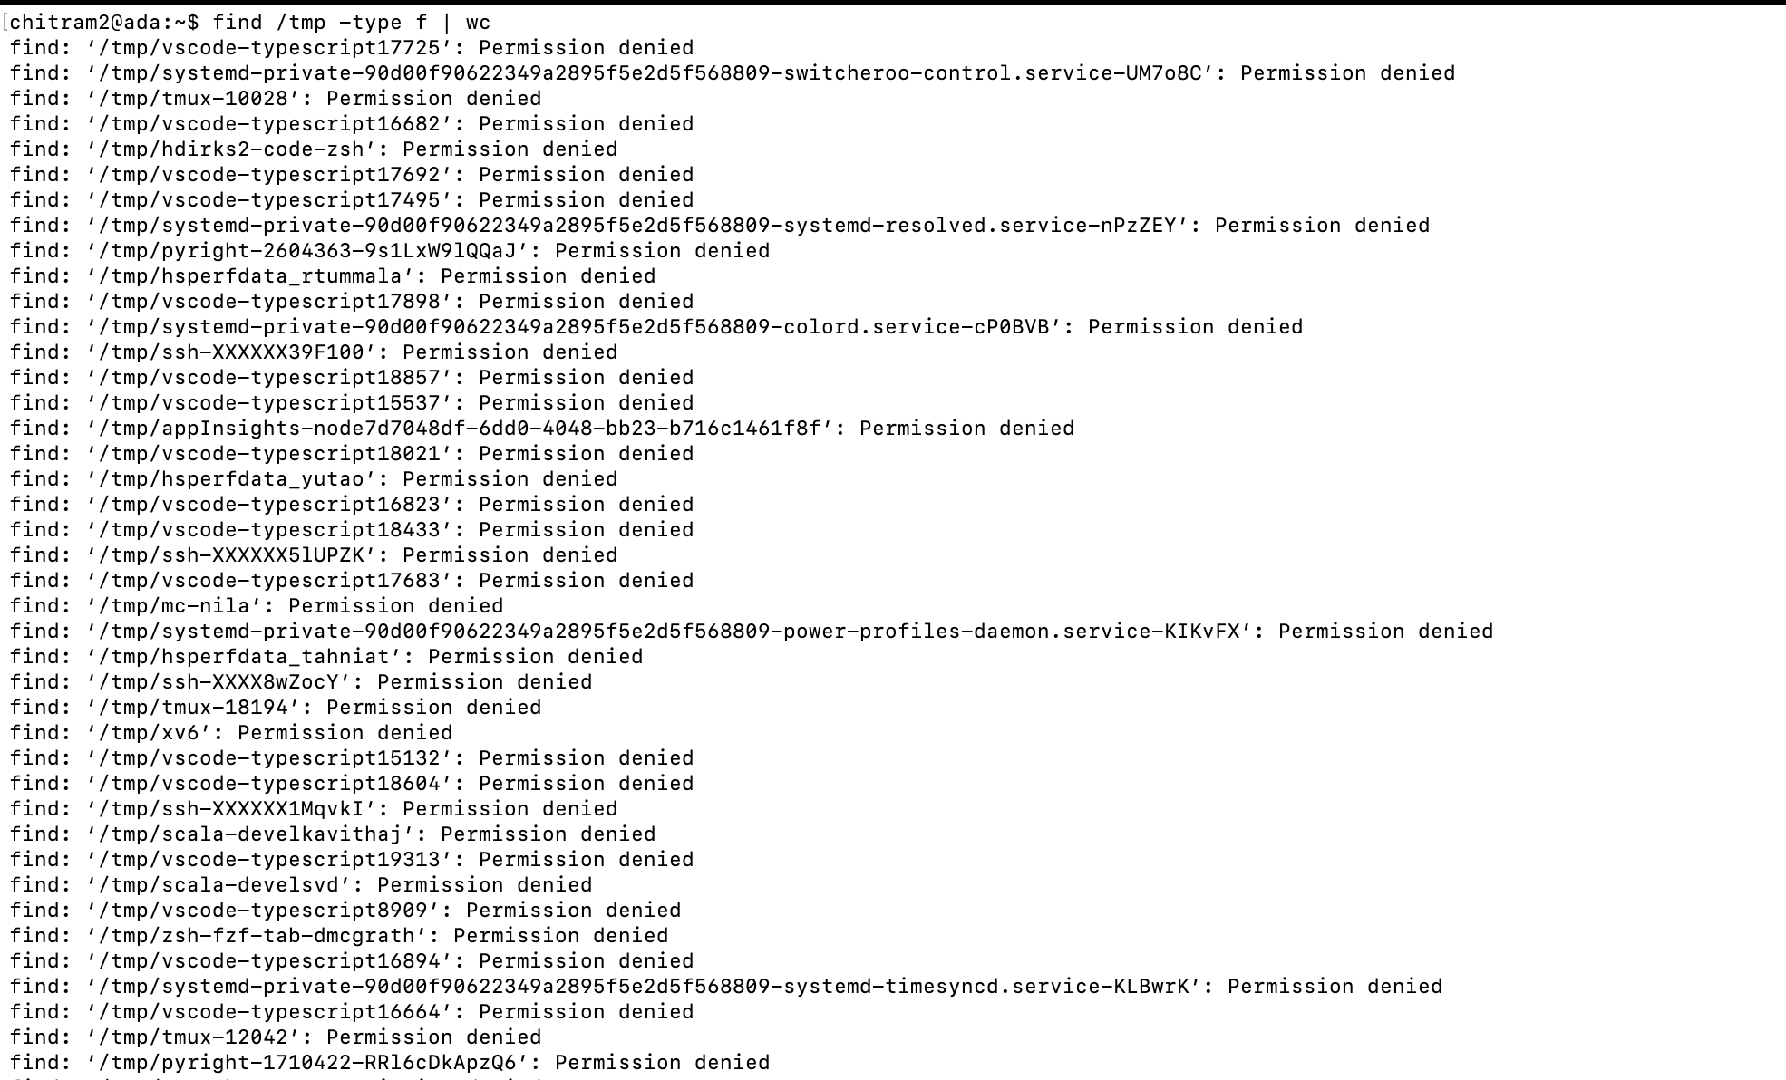

Slide 60
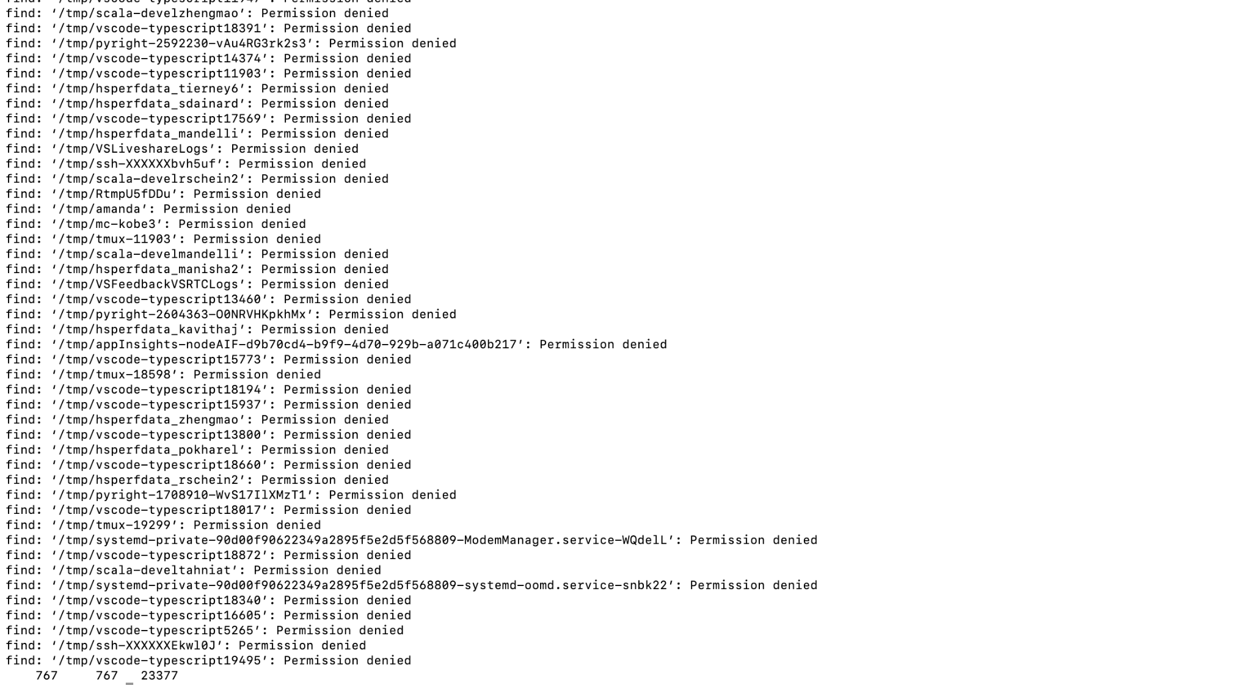

Slide 61
4B. Next, create a detailed memory trace of your find command using the valgrind utility.
Like this: valgrind --tool=lackey --trace-mem=yes find /tmp/ -type f
This generates MANY output lines on the stderr channel. To capture stderr output use 2> on the command line. So the whole thing would look like this:
valgrind --tool=lackey --trace-mem=yes find /tmp/ -type f 2> mytrace.out
How large is your trace (how many text lines in the trace file)?

Slide 62
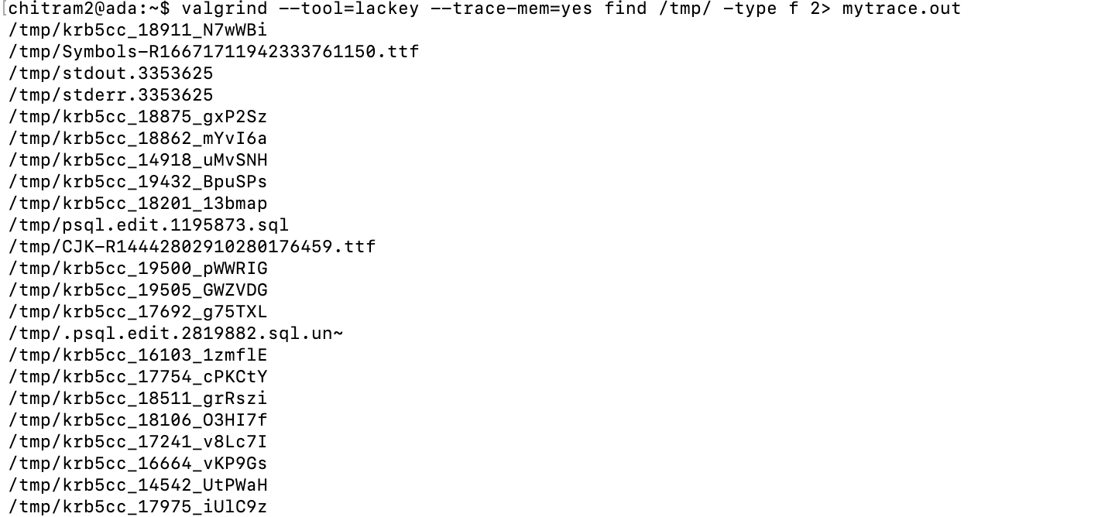
valgrind --tool=lackey --trace-mem=yes find /tmp/ -type f 2> mytrace.out

Slide 63
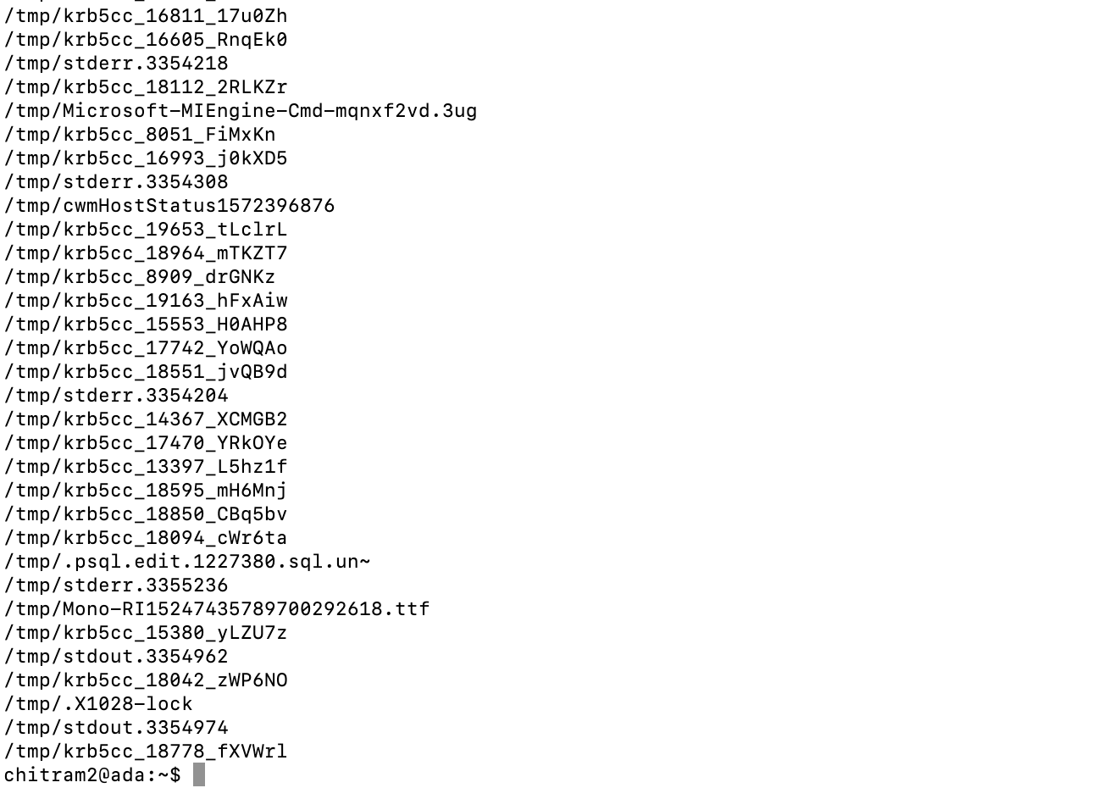

Slide 64

How large is your trace (how many text lines in the trace file)?
8021456 text lines in the trace file
Good

Slide 65
4C. Next, convert your valgrind trace to a format that can be analyzed by the paging-policy.py program. We created a python utility called vgxlate.py for this purpose. Find/download vgxlate.py linked from the Virtualization course plan page on our class website and move it to your linux system.
Run it like this: python vgxlate.py < mytrace.out > pages.trc
How many unique pages were referenced by your find? To calculate the number of unique pages, sort the translated trace file, eliminate duplicate lines and then count the lines. Like this: sort pages.trc | uniq | wc

Slide 66

Looks good now
392 Unique pages were referenced

Slide 67
4D. How do the various page replacement algorithms work for your real trace? Run paging-policy.py -f pages.trc ... to analyze your trace. Here is an example that simulates the CLOCK algorithm with pages.trc:
python3 ./paging-policy.py -f pages.trc -p CLOCK -b 2 -N -c -C 3
How large of a page cache do you need in order to achieve a hit ratio of 98%?
Answer this question for RAND, LRU, FIFO and CLOCK (with -b 2). Does the page cache size change significantly for these four algorithms.

Slide 68

RAND statistics for 98% hit-ratio

Slide 69

LRU statistics for 98% hit-ratio

Slide 70

FIFO statistics for 98% hit-ratio

Slide 71

CLOCK statistics for 98% hit-ratio

Slide 72
Does the page cache size change significantly for these four algorithms.
Yes, the page cache size changes significantly for these four algorithms.
1)RAND: 21
2)FIFO: 21
3)CLOCK: 18
4)LRU: 16
Good

Slide 73
4E. Note that we did not ask you compute the 98% ratio cache size for the OPT algorithm. Why do you suppose we skipped that one?
Please see next slide for answer

Slide 74

we tried OPT algorithm and it is time consuming than other algorithms. It is taking very long time to run and hangs. It would have taken a long time to achieve 98% hit ratio.
Screenshot for reference:
Good

Slide 75
4F. Share your observations about the relative performance of LRU, FIFO, RAND and CLOCK for your real program page trace.
Answer:
The relative performance of the algorithms for the trace program is based on the page size and cache miss / cache hit.
we know that for the page size are:
1)RAND: 21
2)FIFO: 21
3)CLOCK: 18
4)LRU: 16
Therefore, we can say that in terms of page size, RAND and FIFO required the highest size for achieving the 98% hit ratio, followed by CLOCK and the best being LRU which needed the lowest size.
Good

Slide 76
For cache miss are:
1)LRU - 157535 misses
2)RAND- 157148 misses
3)FIFO - 156105 misses
4)CLOCK- 154859 misses
From the above data, we know that LRU had the highest number of cache misses and CLOCK is the lowest.
Good

